Slide 1
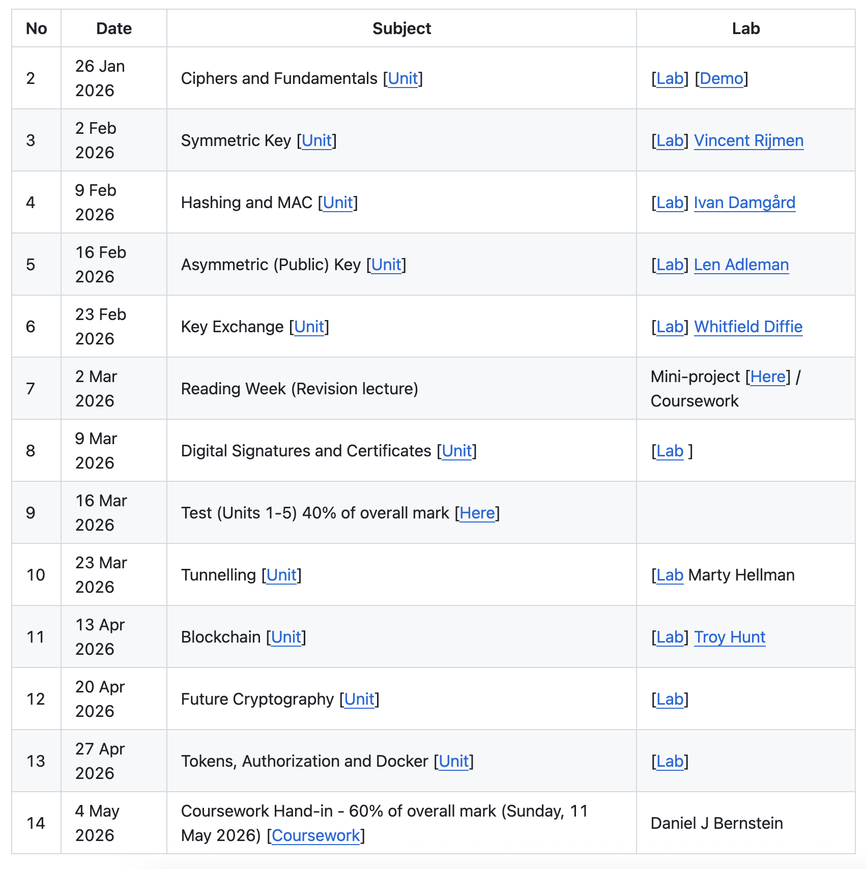

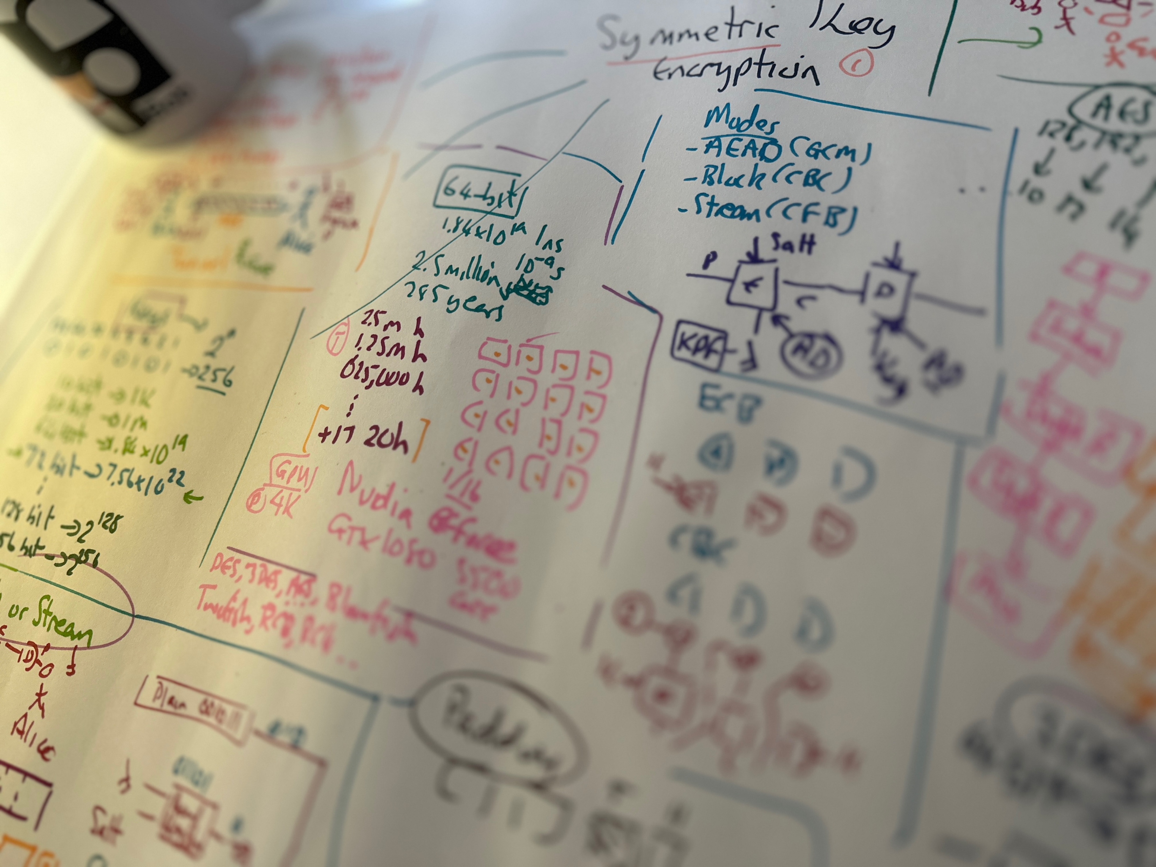
2. Symmetric Key Basics Block or Stream? Secret Key Methods Salting AES: Creation and Modes 3DES
ChaCha20/Poly1305 and RC4 Key Entropy Cloud-based Symmetric Key Prof Bill Buchanan OB, FRSE https://asecuritysite.com/symmetric

Slide 2
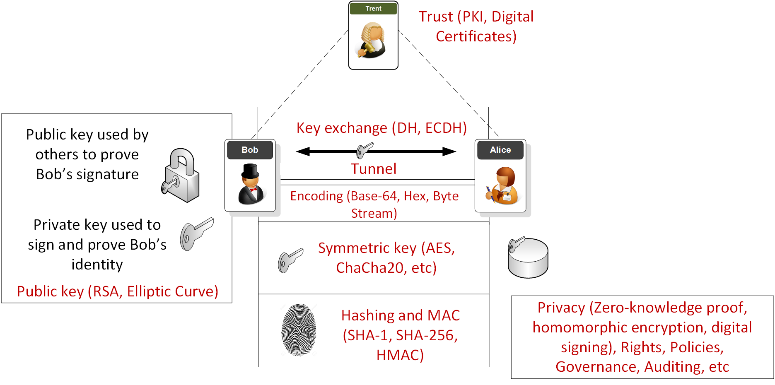
Overview

Slide 3
Puzzle
For a 128-bit key and brute force, how long would it take to crack a single key for 10 billion tries per second?
10 days?
100 days?
1 year?
10 years?
100 years?

Slide 4
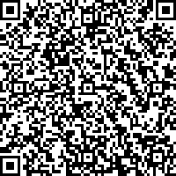
For a 128-bit key and brute force, how long would it take to crack a single key for 10 billion tries per second?
529 million million million years - Boil every ocean on planet, 16,384 times
Article

Slide 5
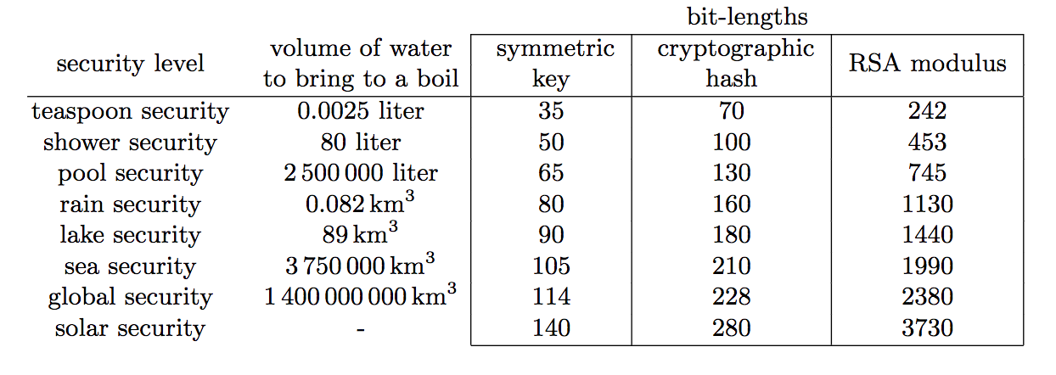
Boiling the planet
Article

Slide 6
2. Symmetric Key Basics Block or Stream? Secret Key Methods Salting AES 3DES
ChaCha20/Poly1305 and RC4 Key Entropy Cloud-based Symmetric Key Prof Bill Buchanan OBE, FRSE https://asecuritysite.com/symmetric

Slide 7
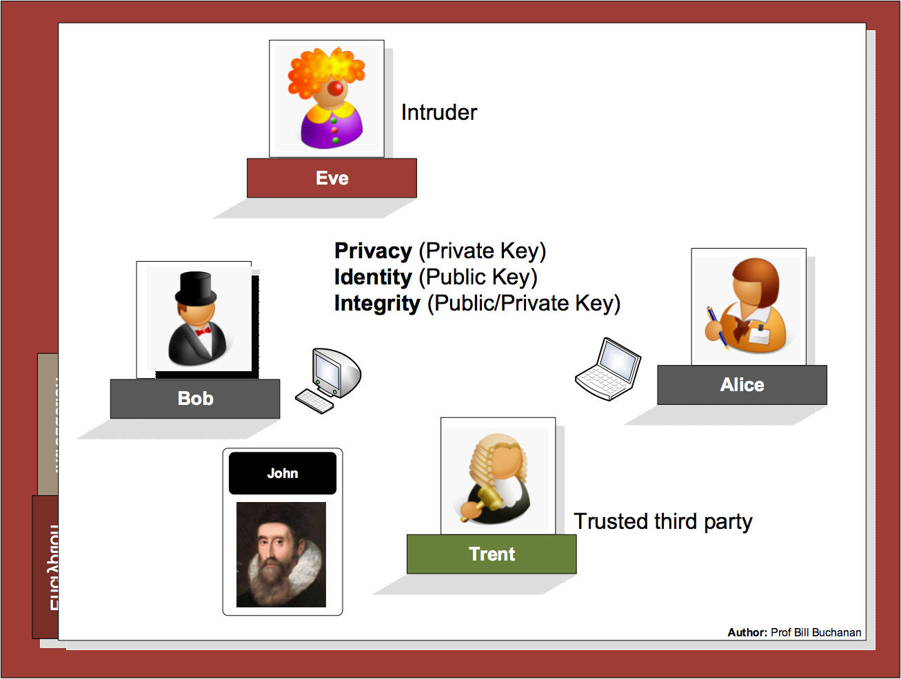

Slide 8
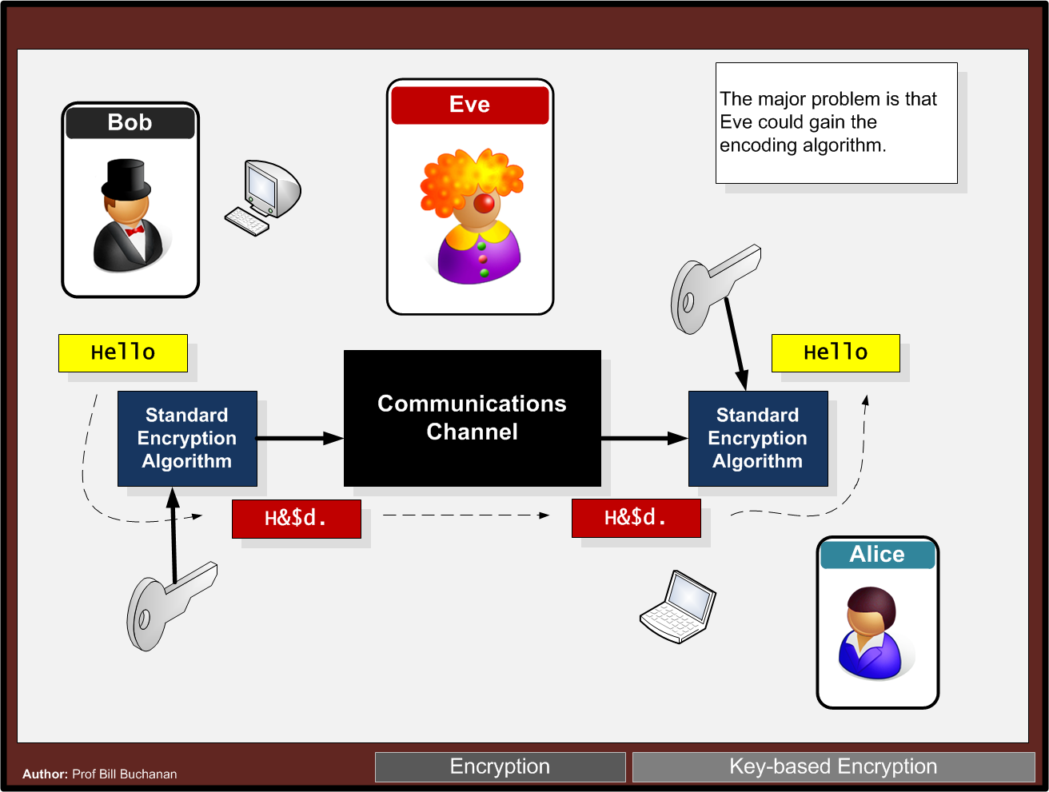

Slide 9
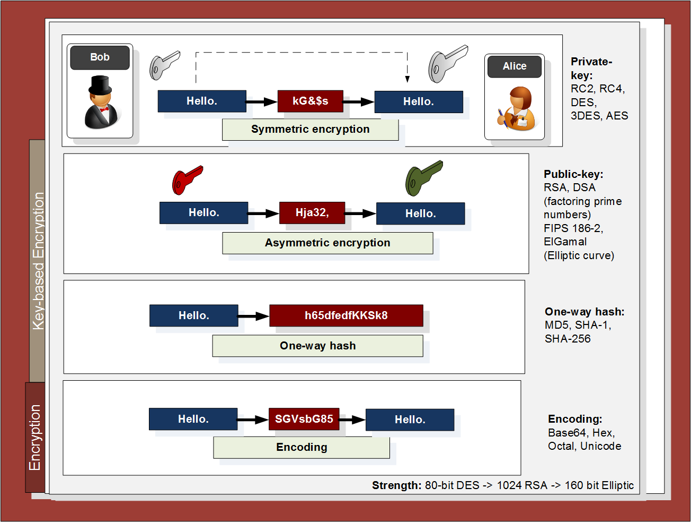

Slide 10
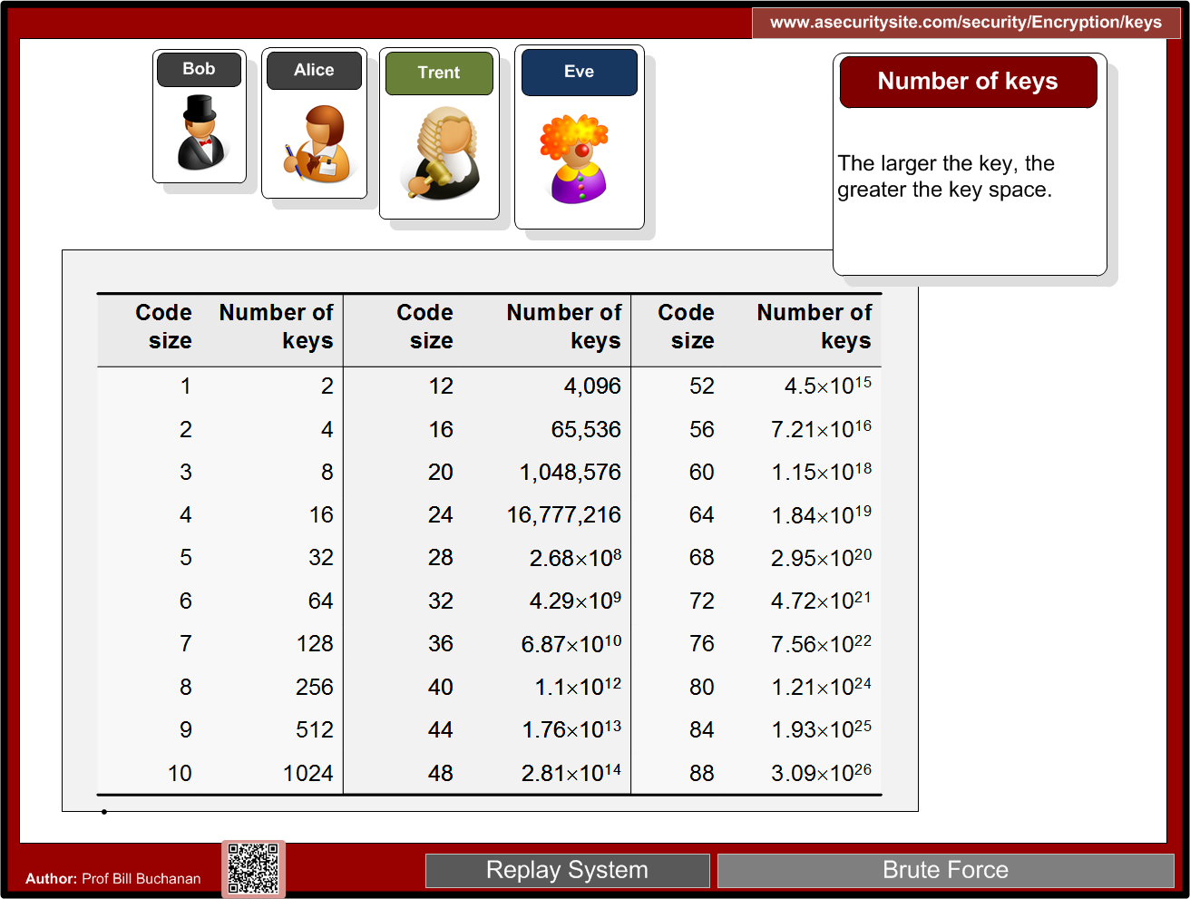

Slide 11
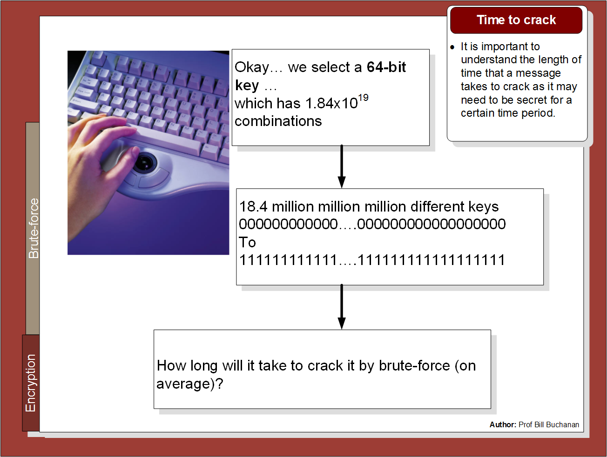

Slide 12
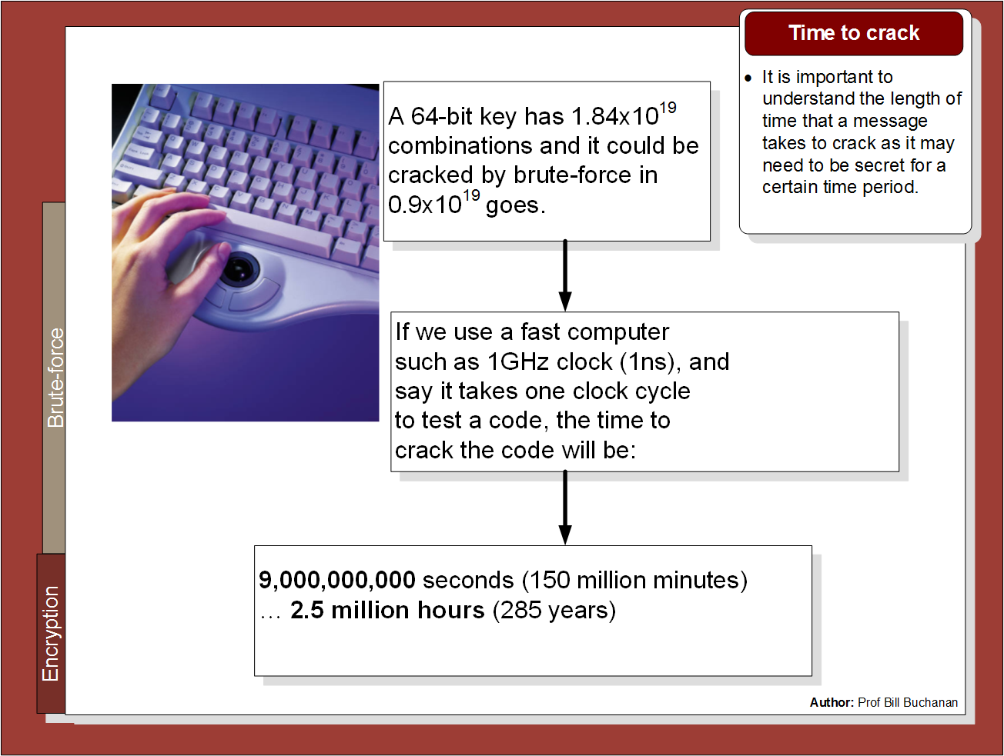

Slide 13
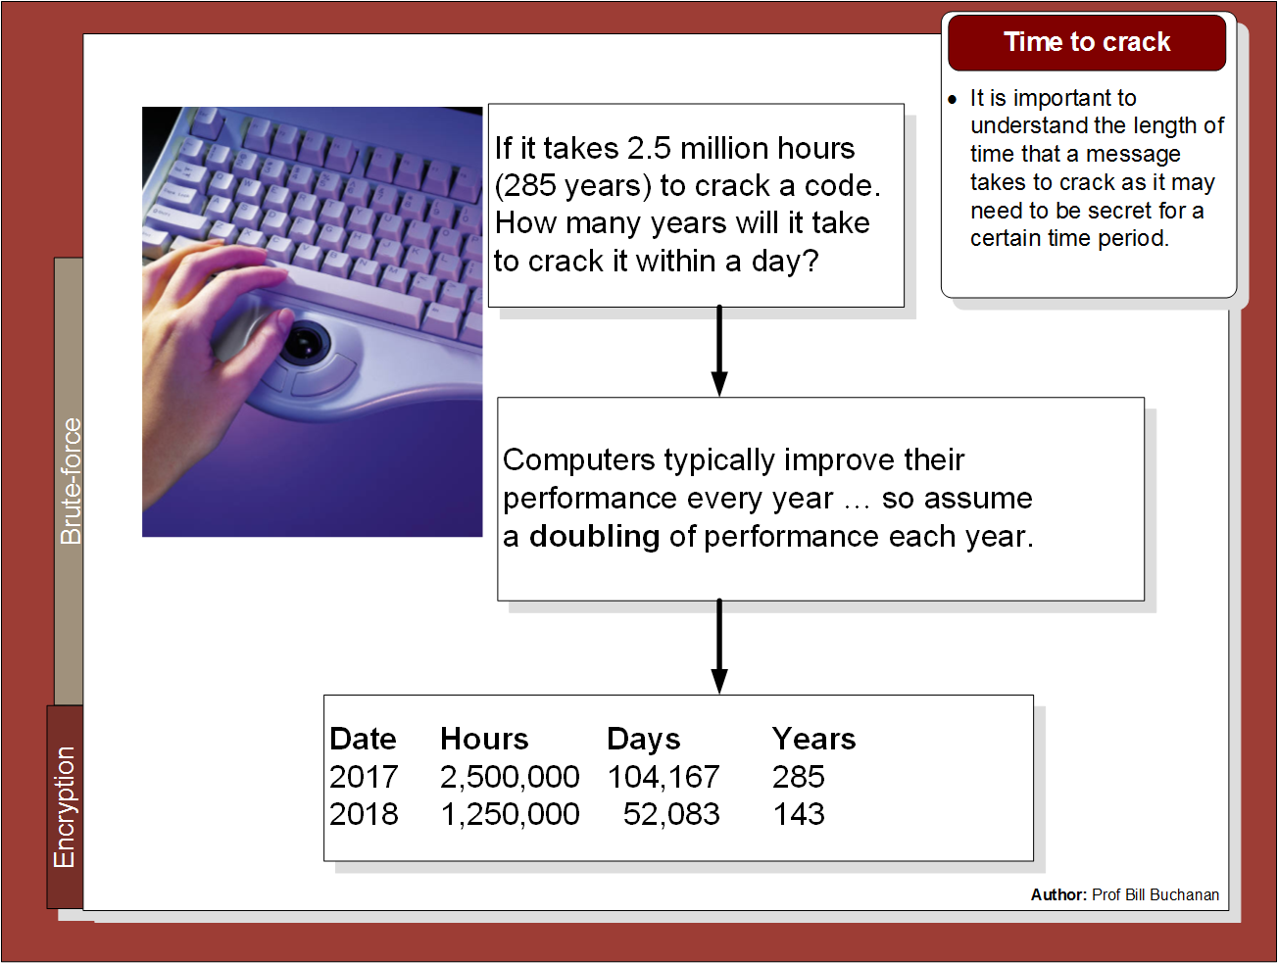

Slide 14
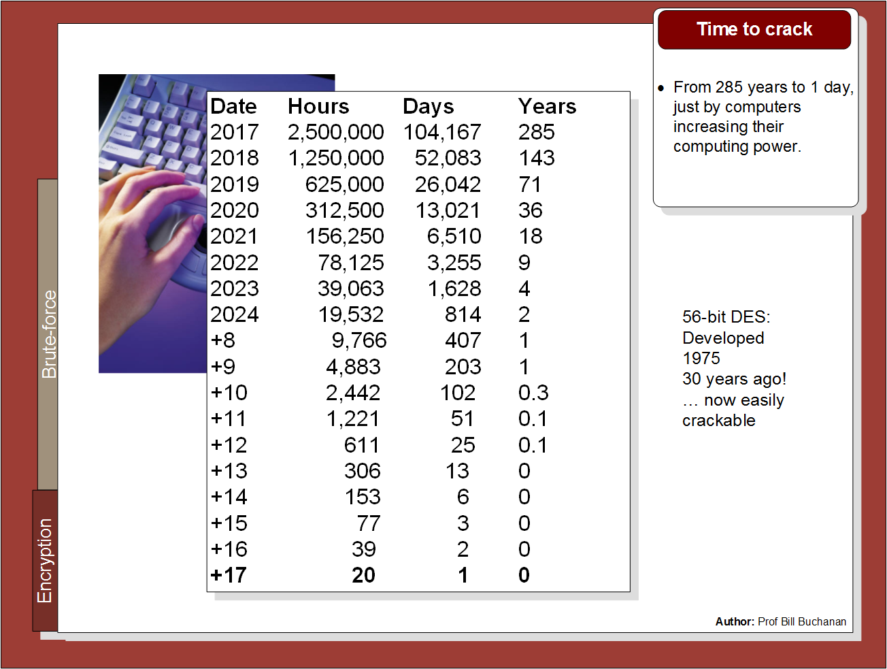

Slide 15
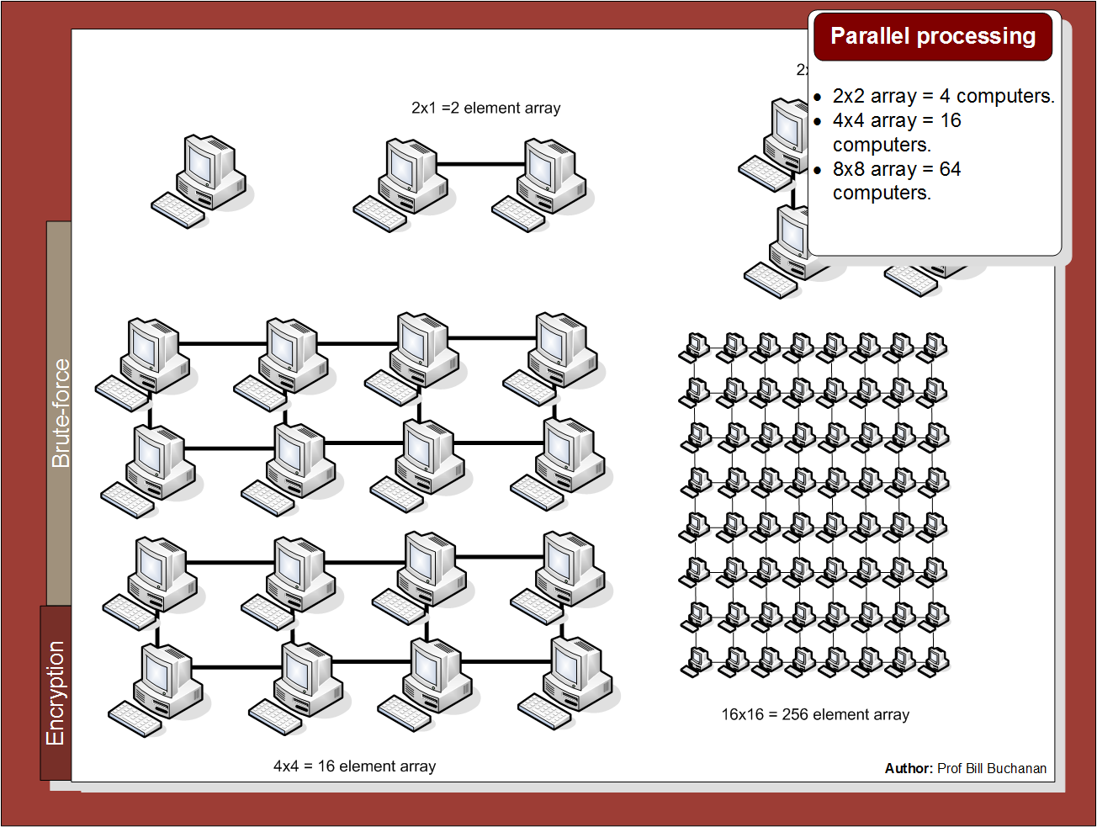

Slide 16
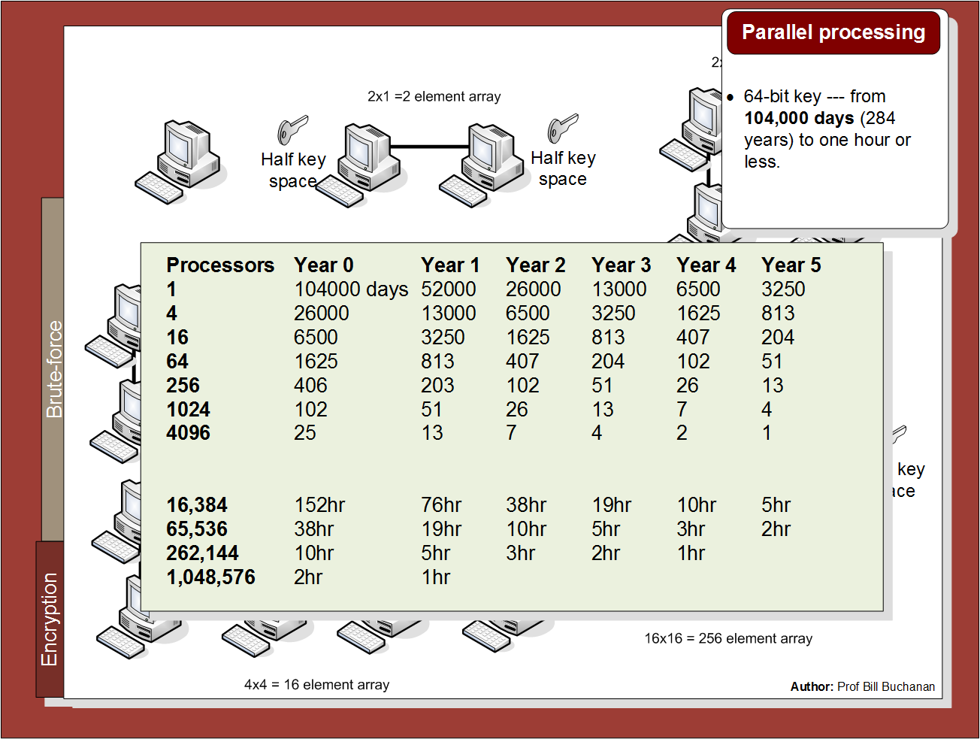

Slide 17
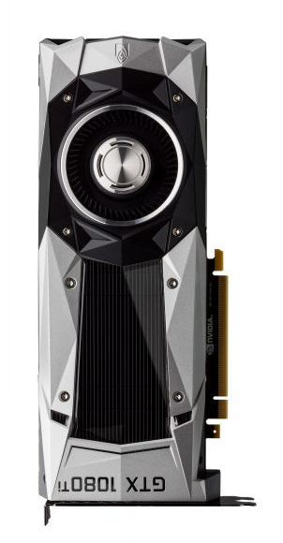

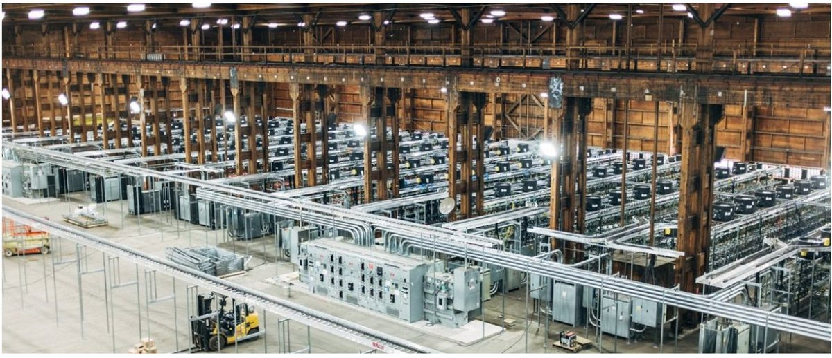
Nvidia GeForce GTX 1080 Ti Specifications: – Graphics Processing Clusters: 6 – Streaming Multiprocessors: 28 – CUDA Cores (single precision): 3584 – Texture Units: 224 – ROP Units: 88 – Base Clock: 1480 MHz – Boost Clock: 1582 MHz – Memory Clock: 5505 MHz – Memory Data Rate: 11 Gbps – L2 Cache Size: 2816K – Total Video Memory: 11264MB GDDR5X – Memory Interface: 352-bit – Total Memory Bandwidth: 484 GB/s – Texture Rate (Bilinear): 331.5 GigaTexels/sec – Fabrication Process: 16 nm – Transistor Count: 12 Billion – Connectors: 3 x DisplayPort, 1 x HDMI – Power Connectors: One 6-pin, One 8-pin – Recommended Power Supply: 600 Watts

Slide 18
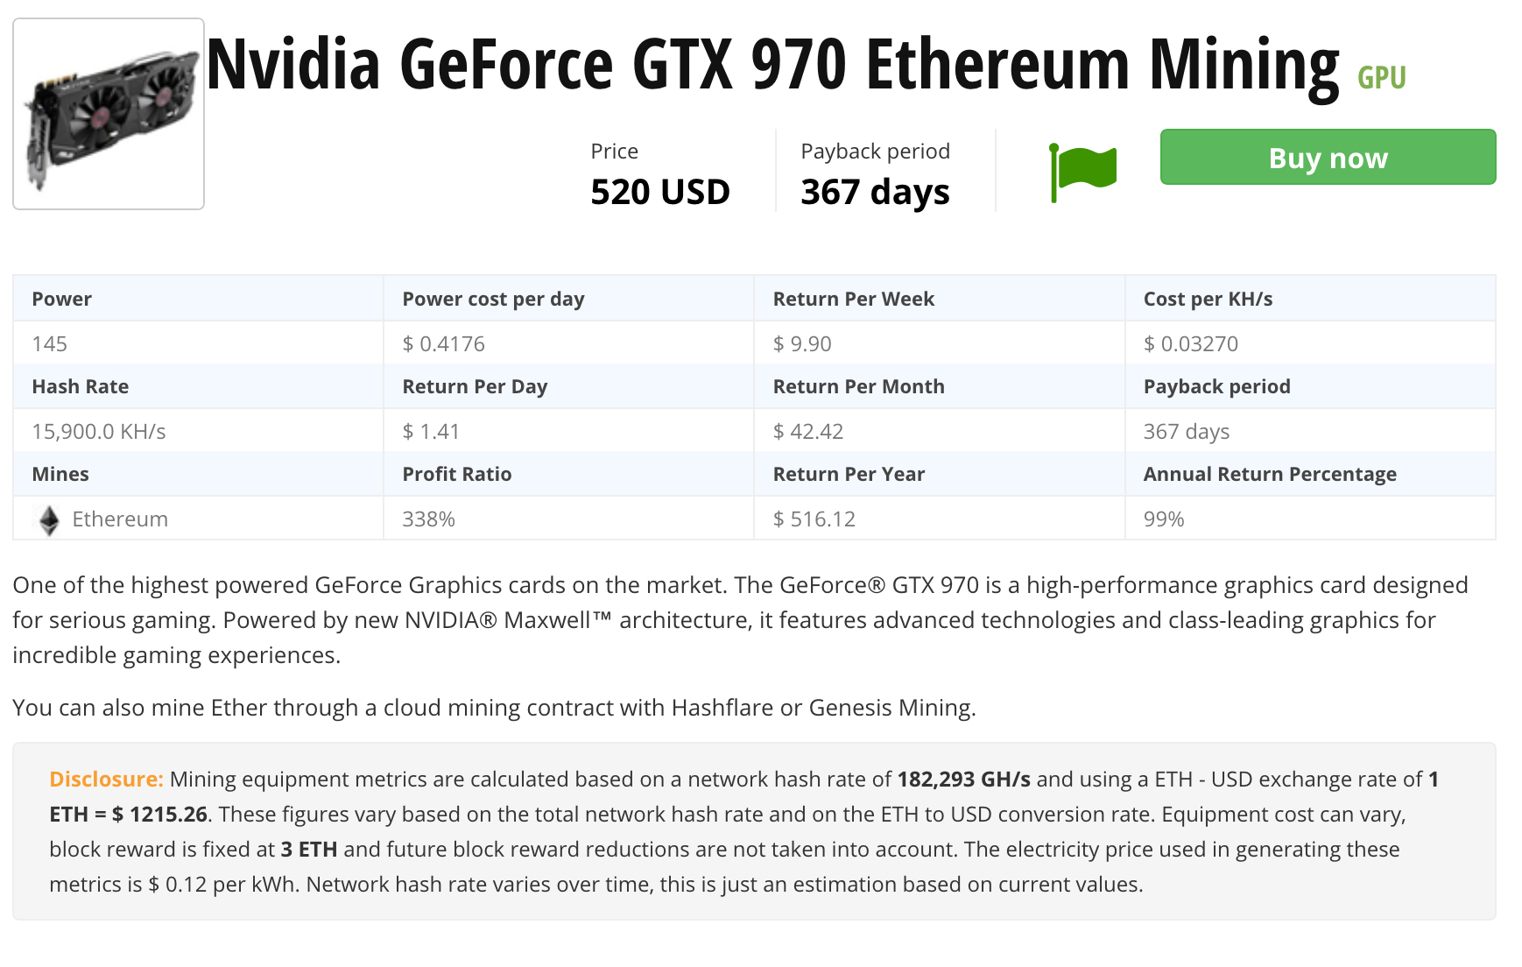


Slide 19
2. Symmetric Key Basics Block or Stream? Secret Key Methods Salting AES 3DES
ChaCha20/Poly1305 and RC4 Key Entropy Cloud-based Symmetric Key Prof Bill Buchanan OBE, FRSE https://asecuritysite.com/symmetric

Slide 20
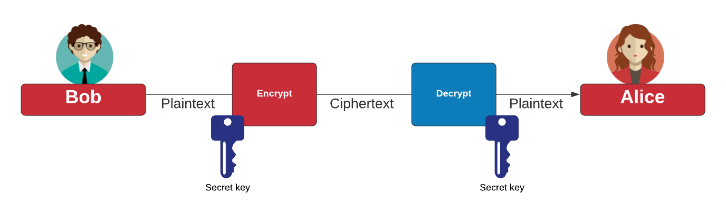
Symmetric Key

Slide 21
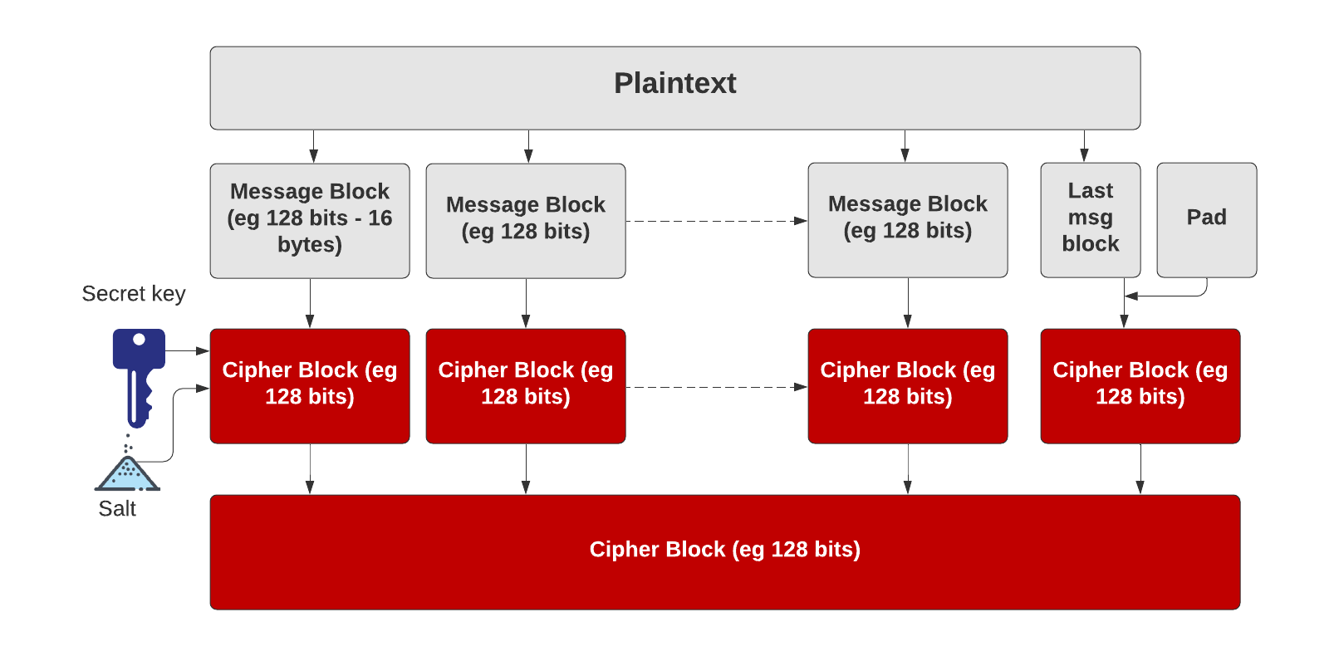
Symmetric Key – Block cipher
https://asecuritysite.com/golang/go_pad

Slide 22
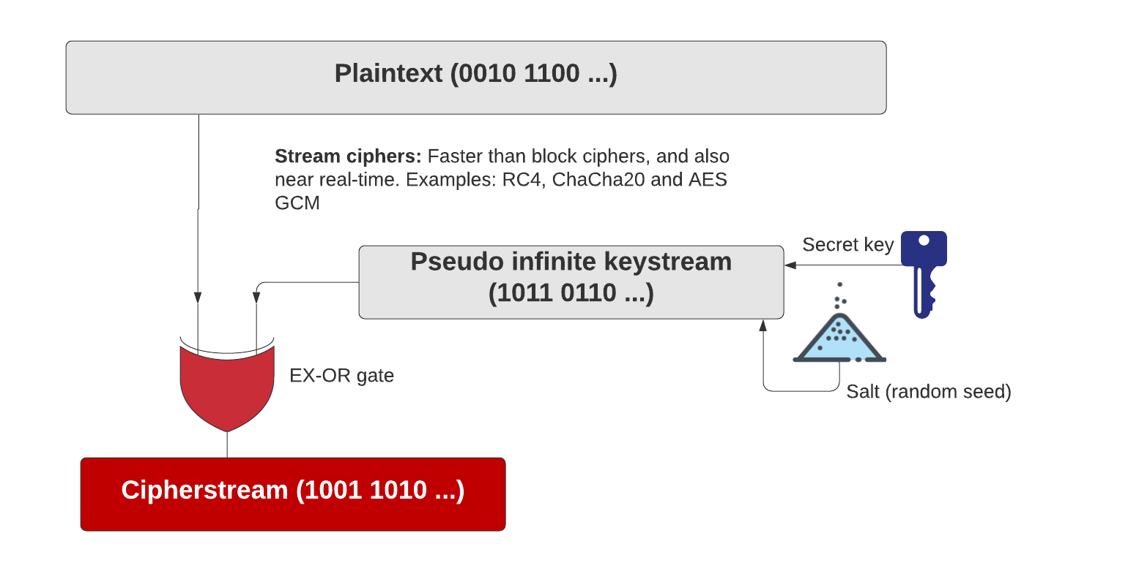
Symmetric Key – Stream cipher
https://asecuritysite.com/golang/go_chacha

Slide 23
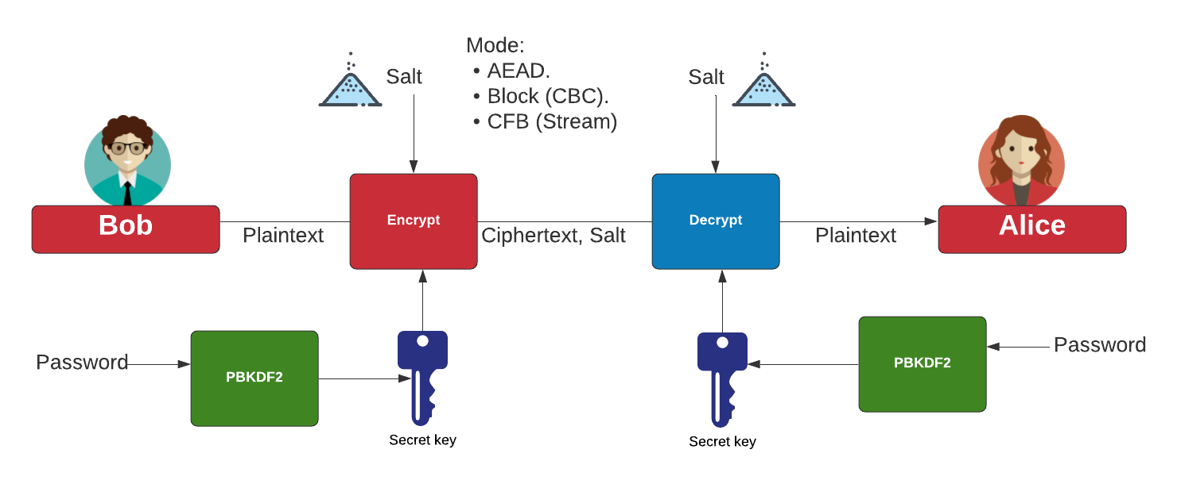
Symmetric Key - Modes
AES Block cipher modes: ECB (No salt), CBC (Cipher Block Chaining).
AES Stream modes: CFB (Cipher Feedback), OFB (Output Feedback), CTR (Counter), GCM (Galois Counter Mode).
https://asecuritysite.com/golang/go_symmetric

Slide 24
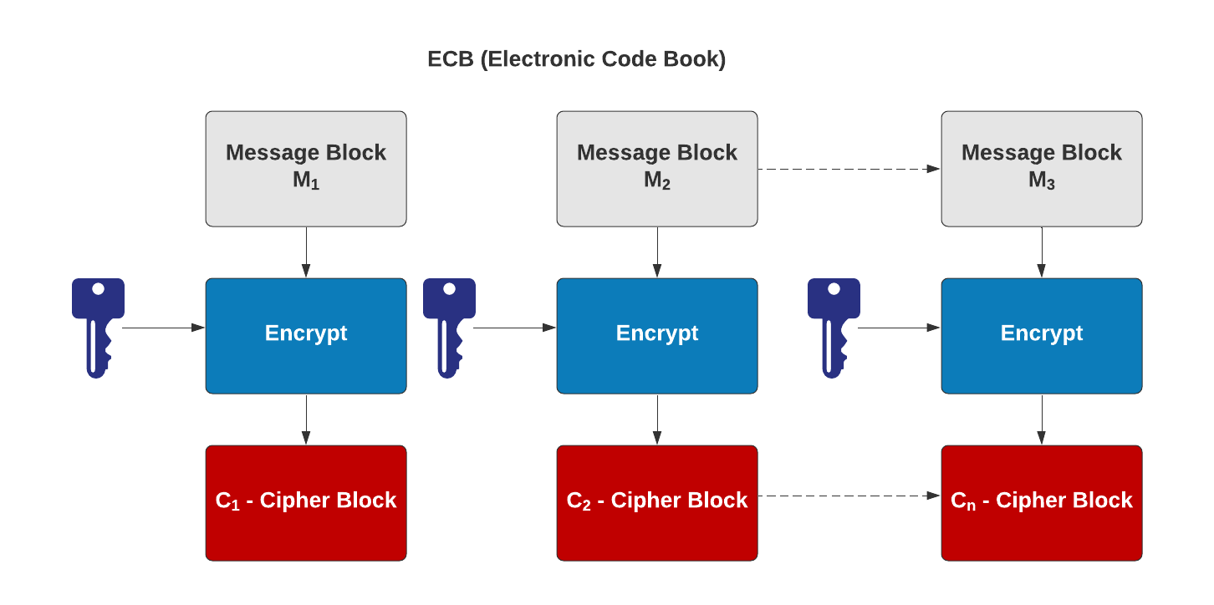
Symmetric Key – Electronic Code Code (ECB)
AES Block cipher modes: ECB (No salt), CBC (Cipher Block Chaining).
AES Stream modes: CFB (Cipher Feedback), OFB (Output Feedback), CTR (Counter), GCM (Galois Counter Mode).
https://asecuritysite.com/golang/go_symmetric

Slide 25
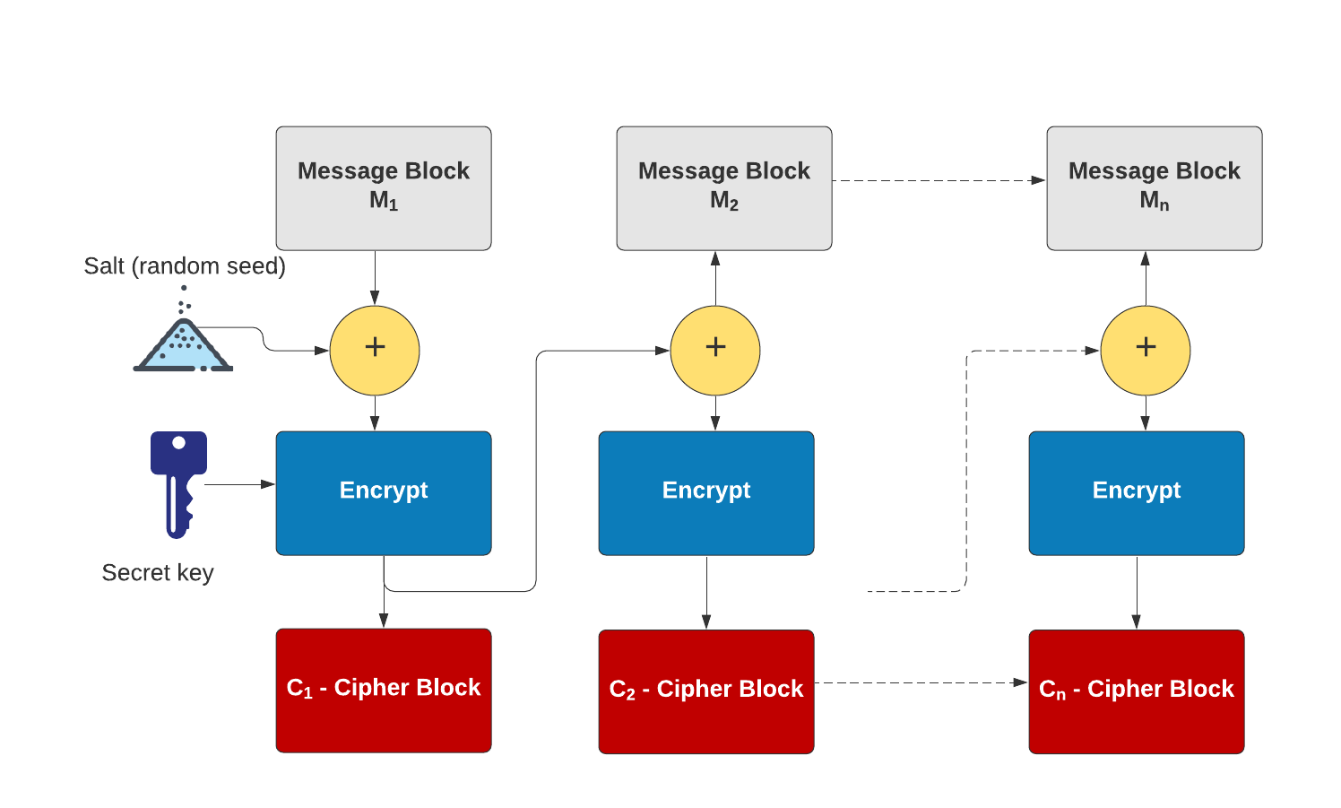
Symmetric Key – Cipher Block Chaining (CBC)
AES Block cipher modes: ECB (No salt), CBC (Cipher Block Chaining).
AES Stream modes: CFB (Cipher Feedback), OFB (Output Feedback), CTR (Counter), GCM (Galois Counter Mode).
https://asecuritysite.com/golang/go_symmetric

Slide 26
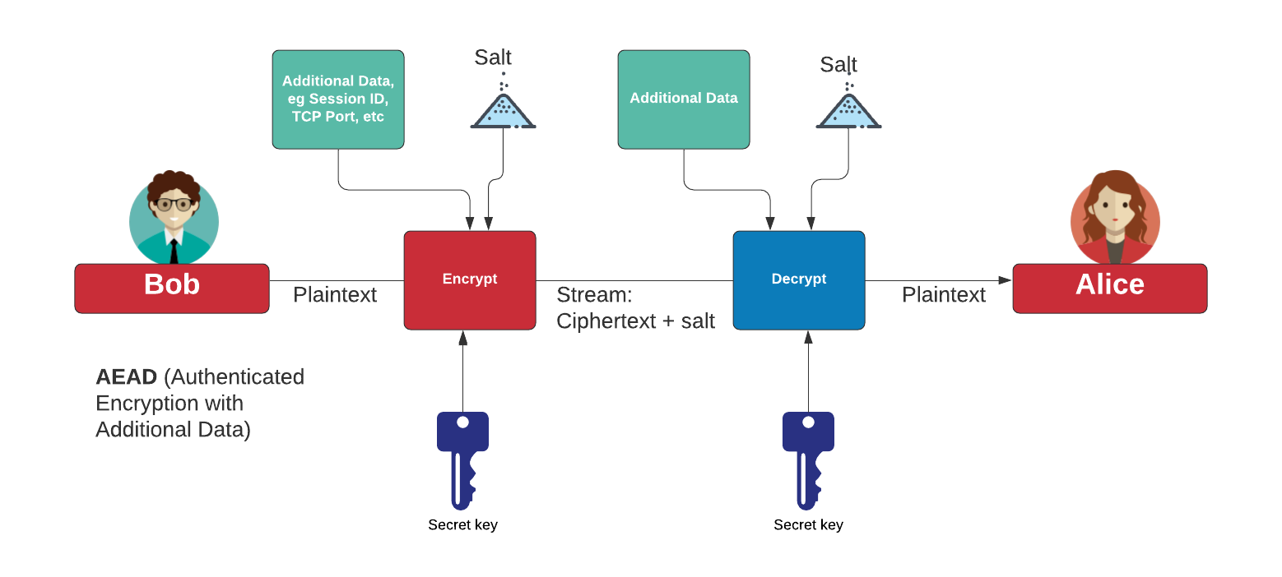
Authenticated Encryption with Additional Data (AEAD)
AES Block cipher modes: ECB (No salt), CBC (Cipher Block Chaining).
AES Stream modes: CFB (Cipher Feedback), OFB (Output Feedback), CTR (Counter), GCM (Galois Counter Mode).
https://asecuritysite.com/golang/go_symmetric

Slide 27
Padding
CMS (Cryptographic Message Syntax). This pads with the same value as the number of padding bytes. Defined in RFC 5652, PKCS#5, PKCS#7 and RFC 1423 PEM.
Bits. This pads with 0x80 (10000000) followed by zero (null) bytes. Defined in ANSI X.923 and ISO/IEC 9797-1.
ZeroLength. This pads with zeros except for the last byte which is equal to the number (length) of padding bytes.
Null. This pads will NULL bytes. This is only used with ASCII text.
Space. This pads with spaces. This is only used with ASCII text.
Random. This pads with random bytes with the last byte defined by the number of padding bytes.

Slide 28

Padding
After padding (CMS): 68656c6c6f0b0b0b0b0b0b0b0b0b0b0b Cipher (ECB): 0a7ec77951291795bac6690c9e7f4c0d
After padding (Bit): 68656c6c6f8000000000000000000000 Cipher (ECB): 731abffc2e3b2c2b5caa9ca2339344f9
After padding (ZeroLen): 68656c6c6f000000000000000000000a Cipher (ECB): d28e2f7e8e44e068732b292bde444245
After padding (Null): 68656c6c6f0000000000000000000000 Cipher (ECB): 444797422460453d95856eb2a1520ece
After padding (Random): 68656c6c6ffc6ecfd884a38798d62a0a Cipher (ECB): c2c88b4364d2c2dc6f2cac9ab73c995d
https://asecuritysite.com/symmetric/go_pad

Slide 29
2. Symmetric Key Basics Block or Stream? Secret Key Methods Salting AES 3DES
ChaCha20/Poly1305 and RC4 Key Entropy Cloud-based Symmetric Key Prof Bill Buchanan OBE, FRSE https://asecuritysite.com/symmetric

Slide 30
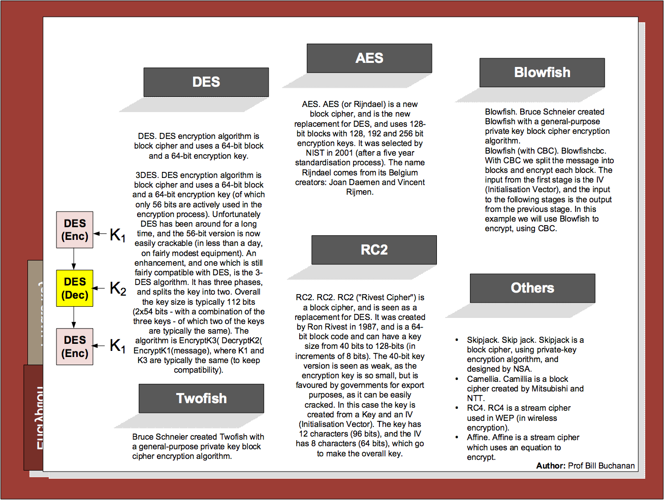

Slide 31
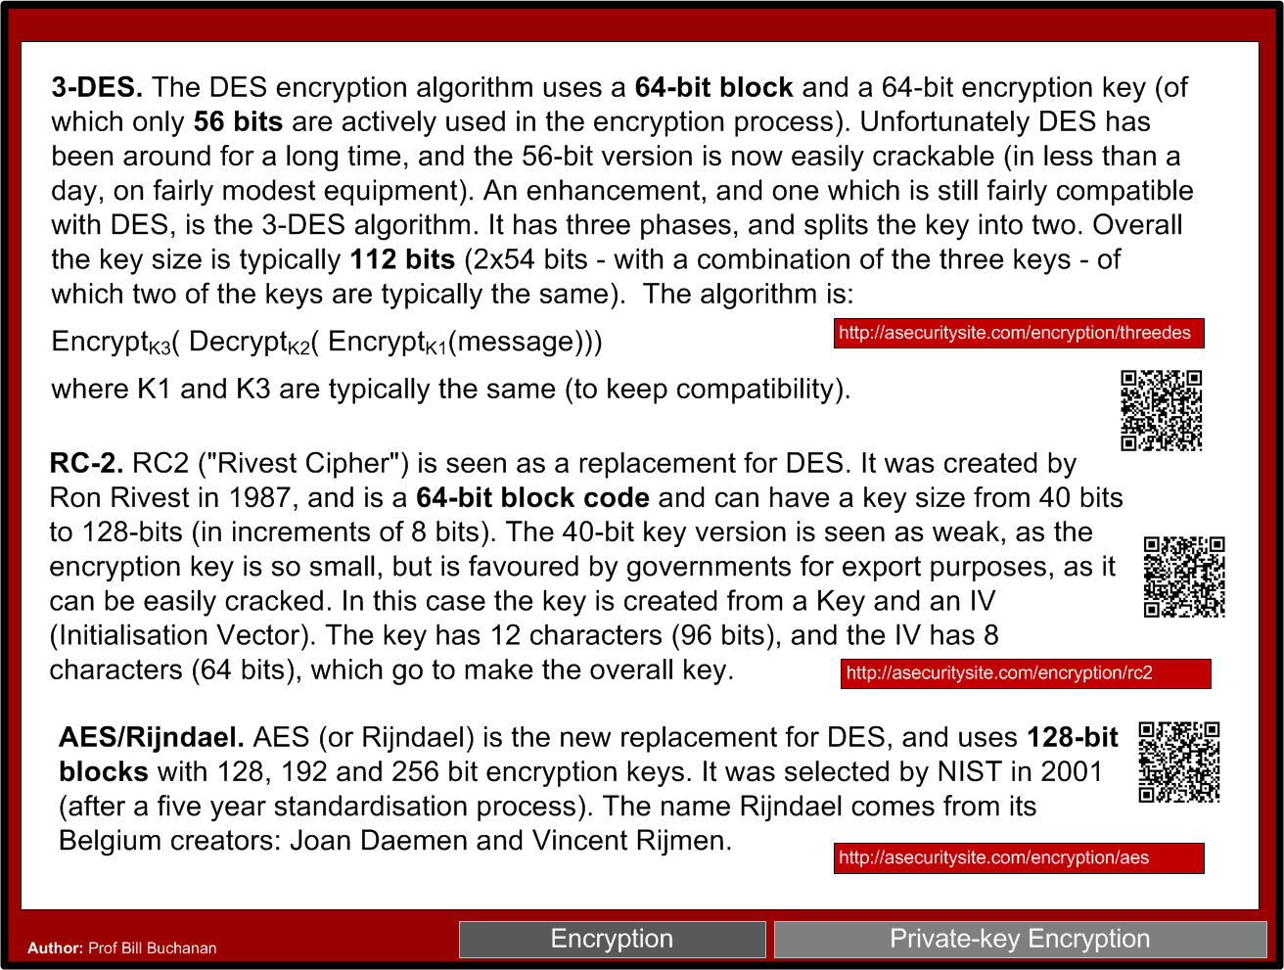

Slide 32
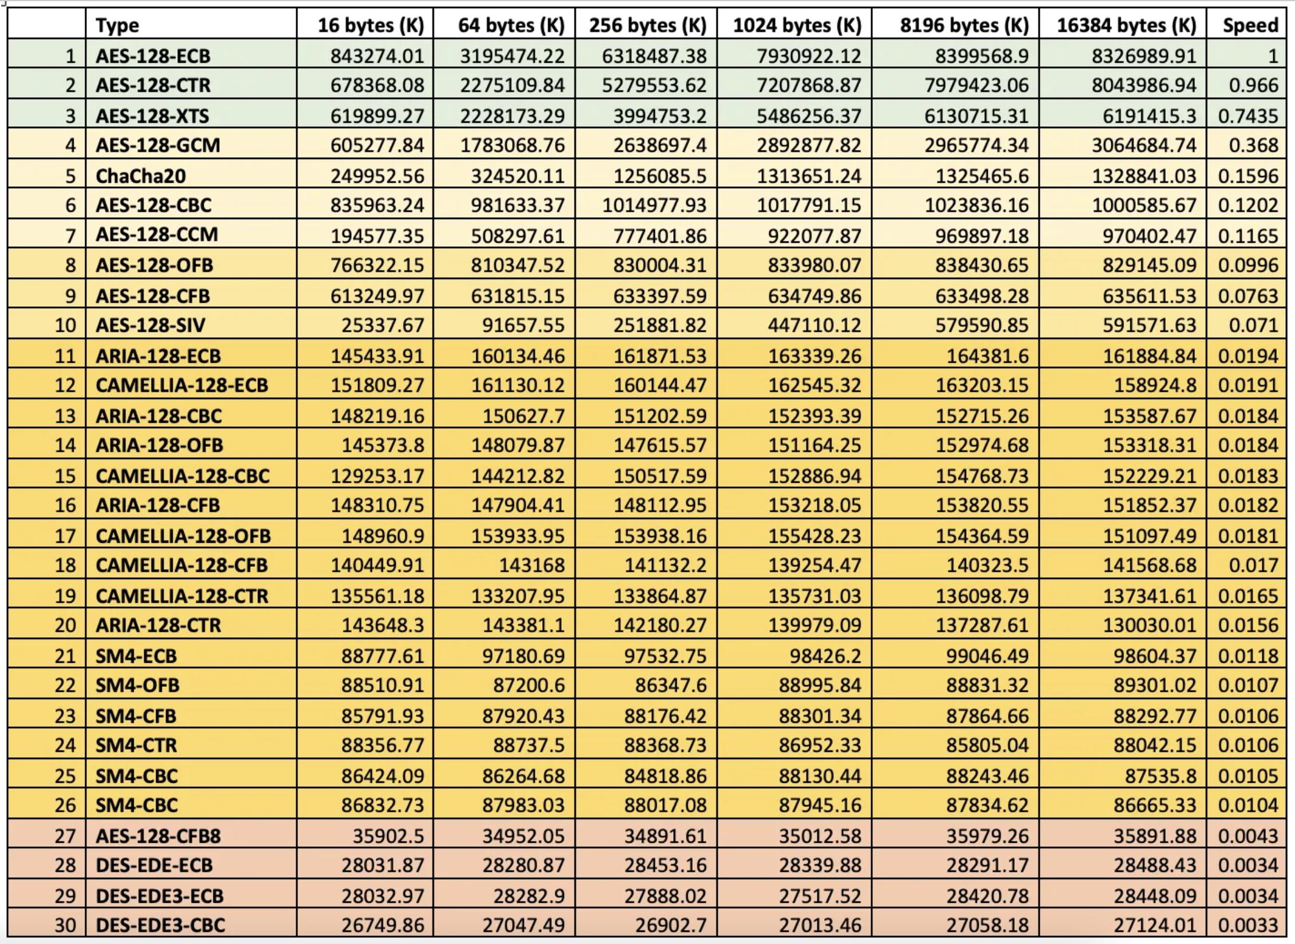
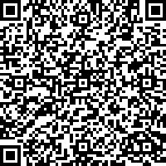
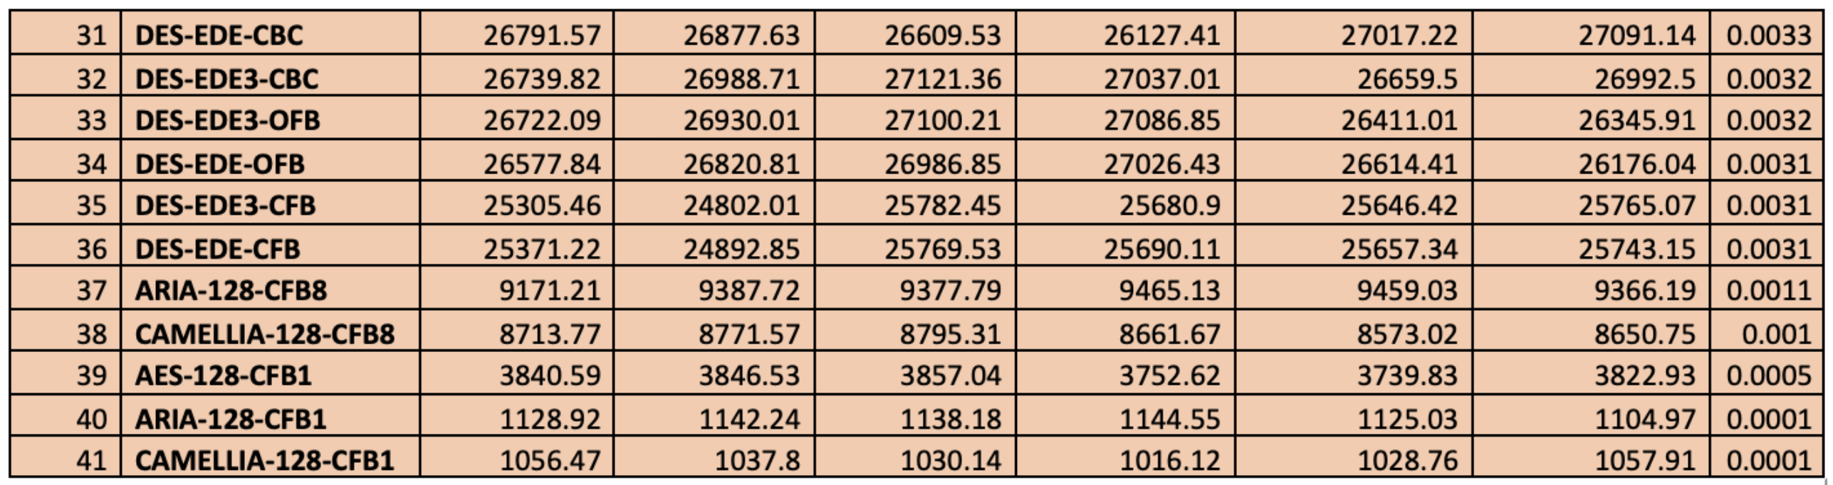

Slide 33


Slide 34
2. Symmetric Key Basics Block or Stream? Secret Key Methods Salting AES 3DES
ChaCha20/Poly1305 and RC4 Key Entropy Cloud-based Symmetric Key Prof Bill Buchanan OBE, FRSE https://asecuritysite.com/symmetric

Slide 35
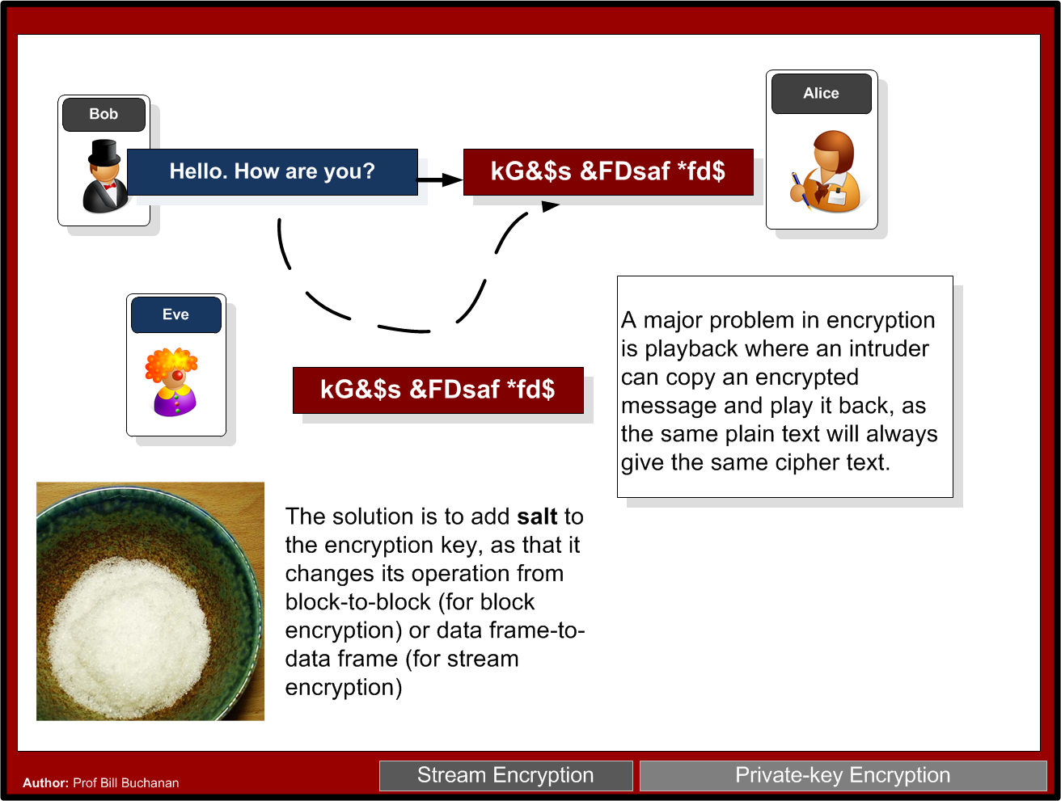

Slide 36
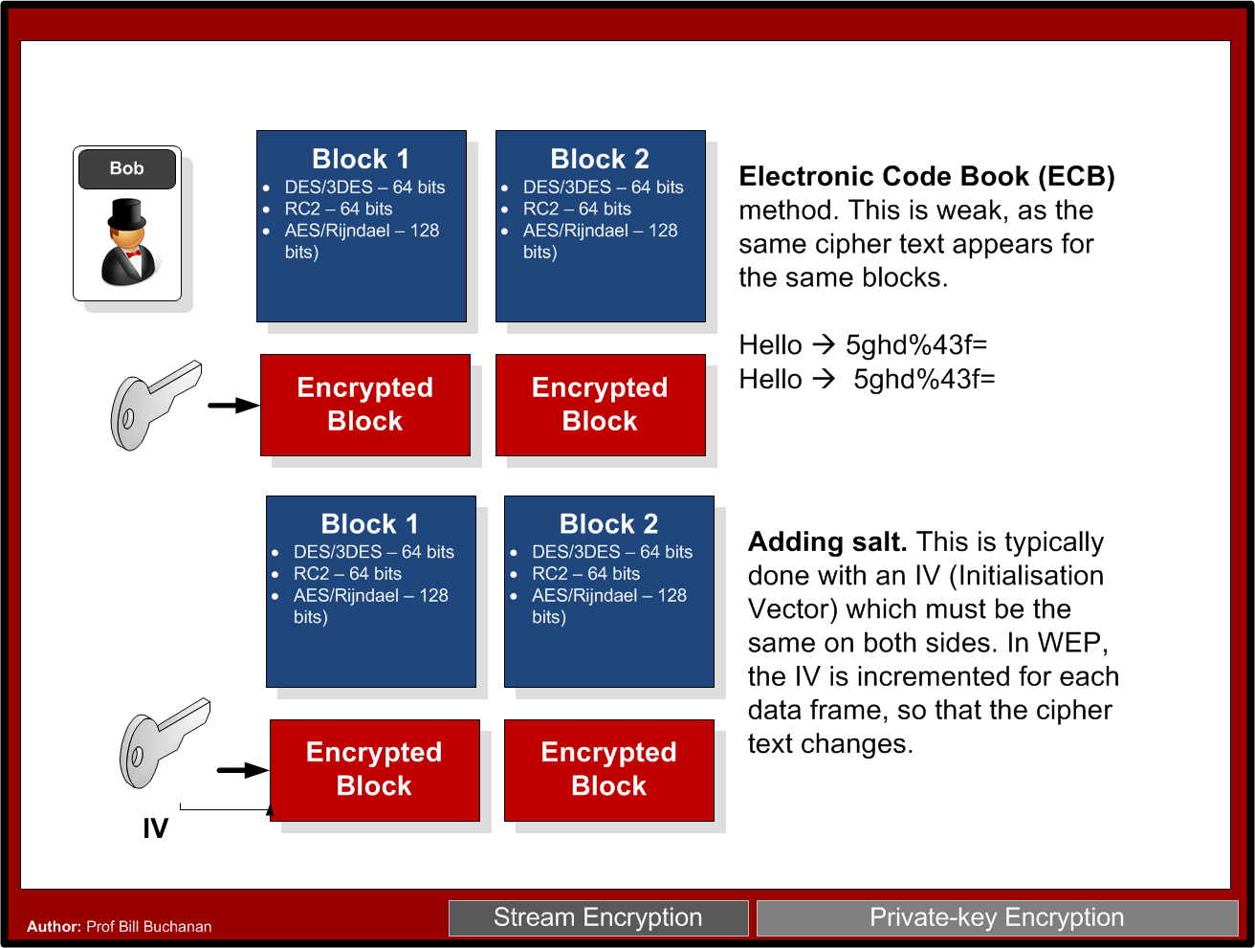

Slide 37
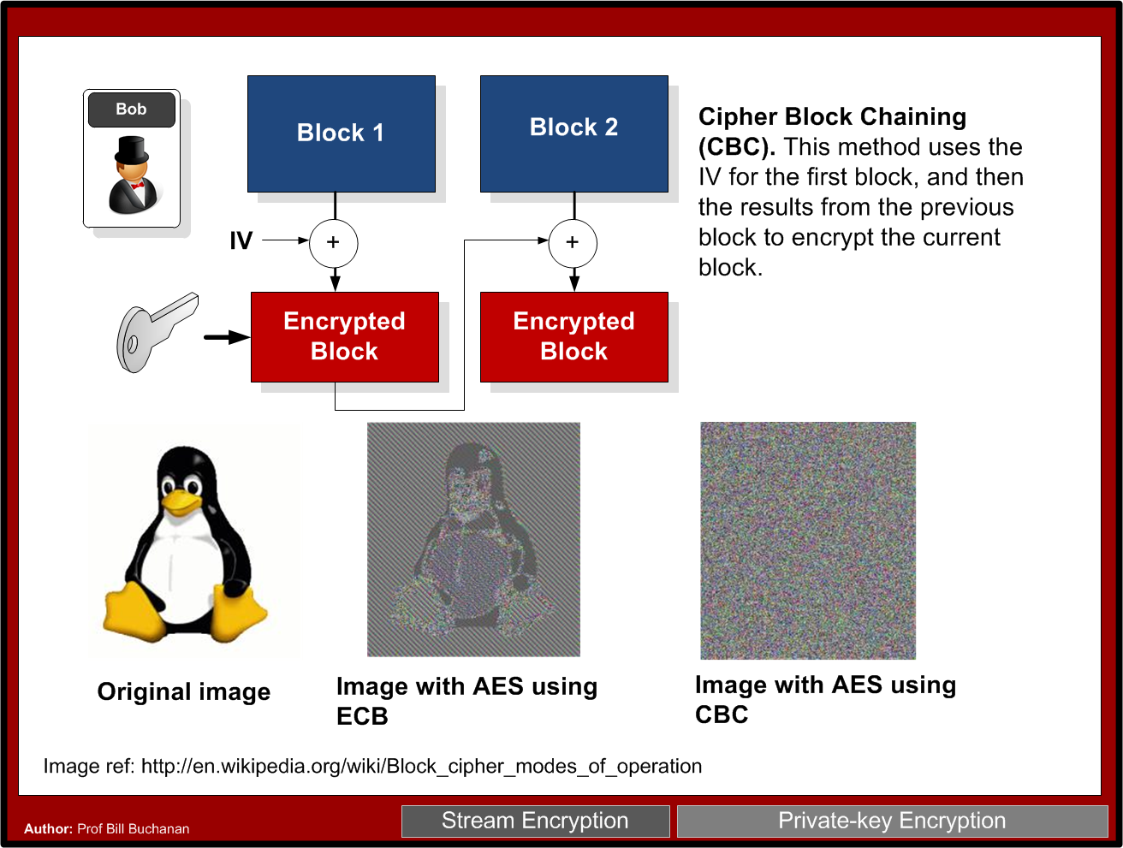

Slide 38
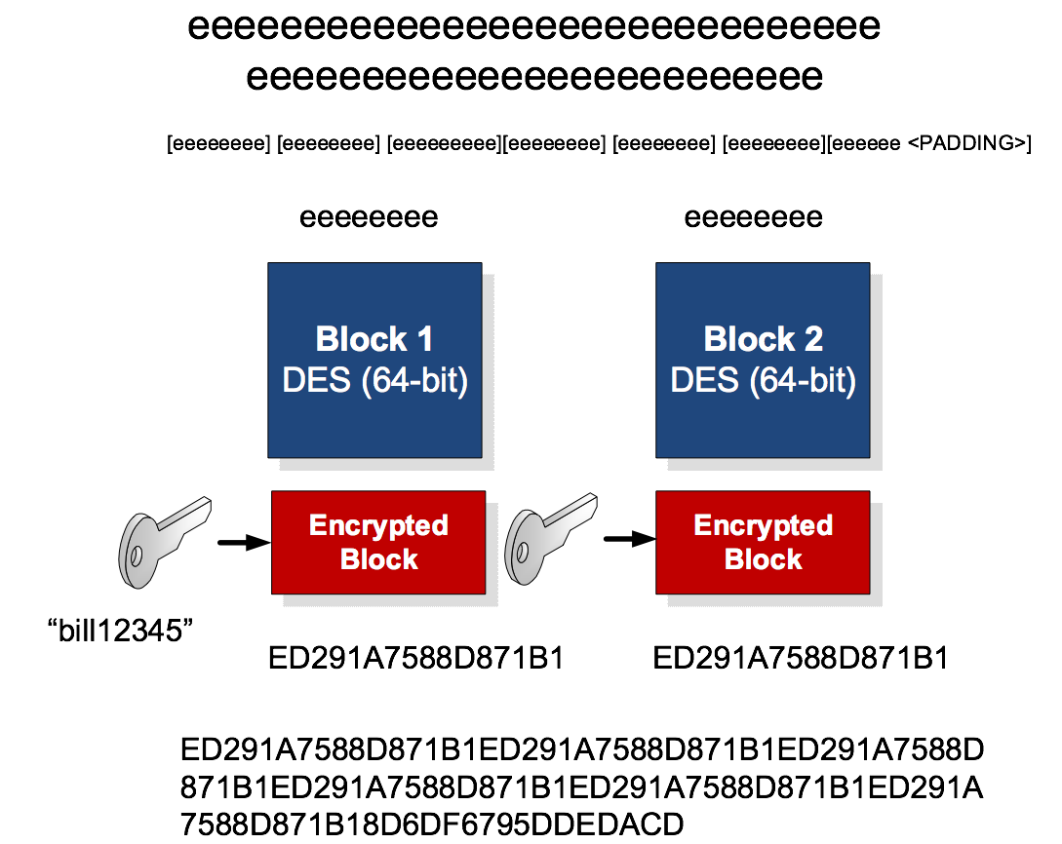

Slide 39

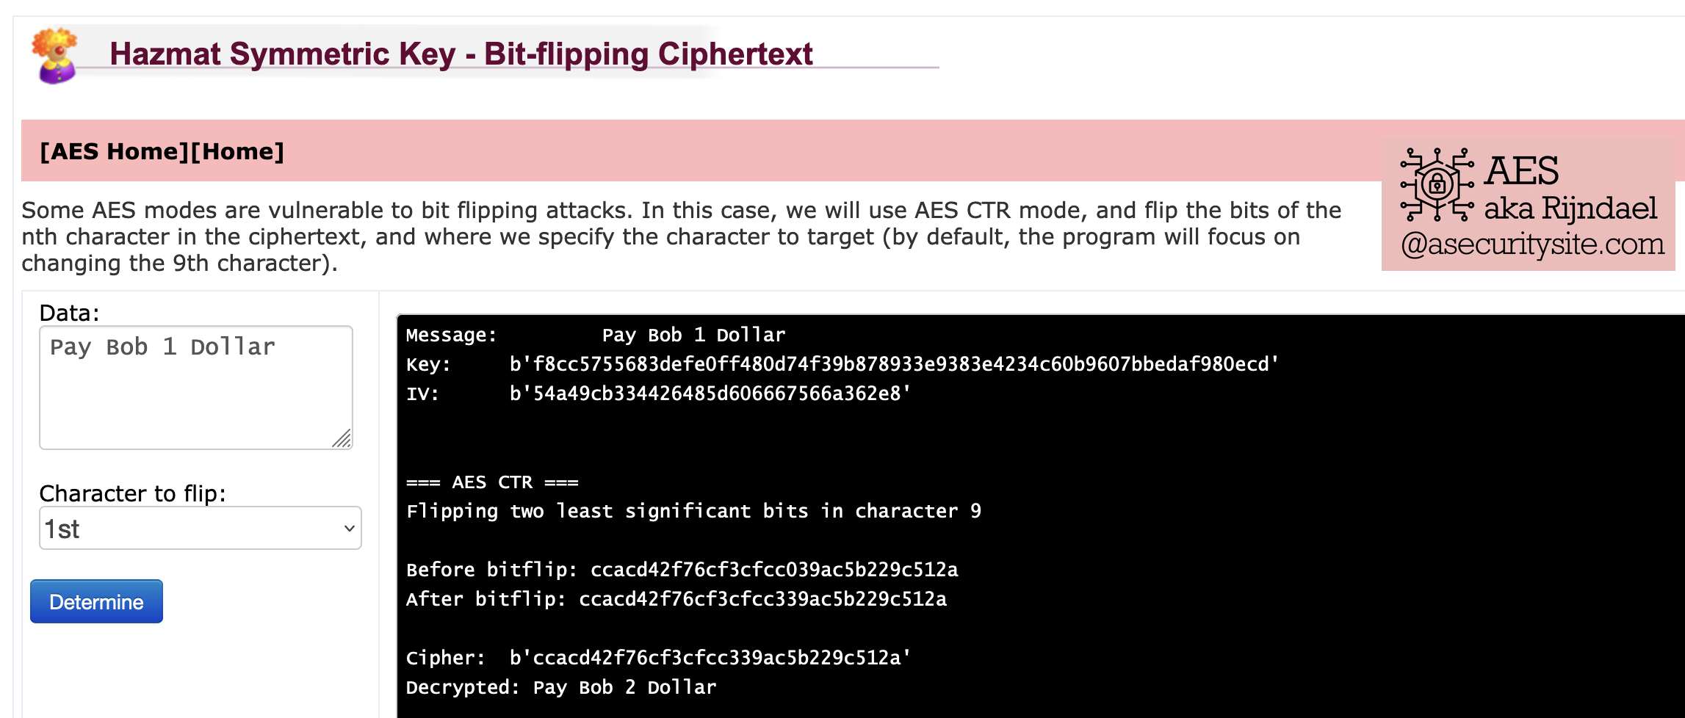
Cipher Cracking

Slide 40
2. Symmetric Key Basics Block or Stream? Secret Key Methods Salting AES 3DES
ChaCha20/Poly1305 and RC4 Key Entropy Cloud-based Symmetric Key Prof Bill Buchanan OBE, FRSE https://asecuritysite.com/symmetric

Slide 41
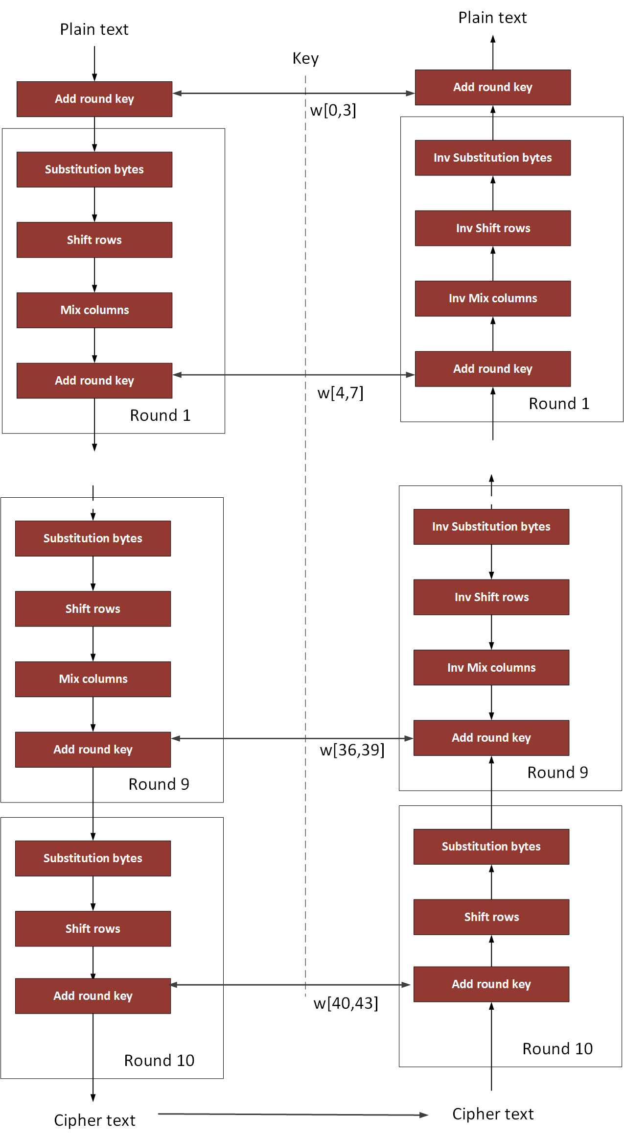
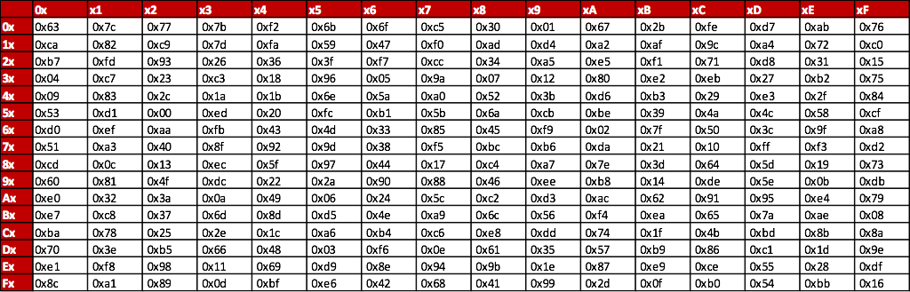
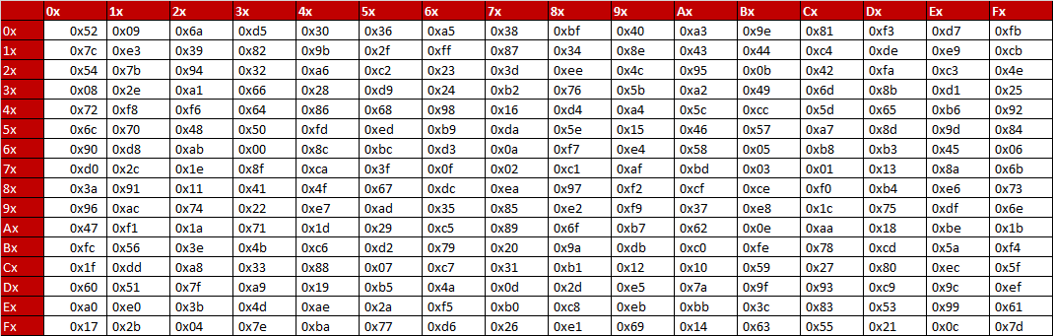
AES
NIST

Slide 42
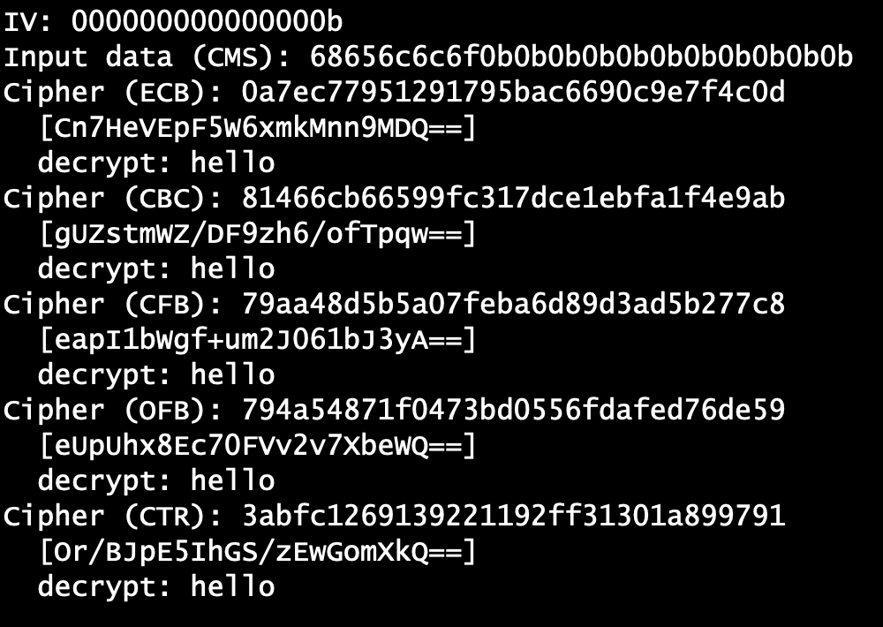

AES Modes
Example
ECB

Slide 43
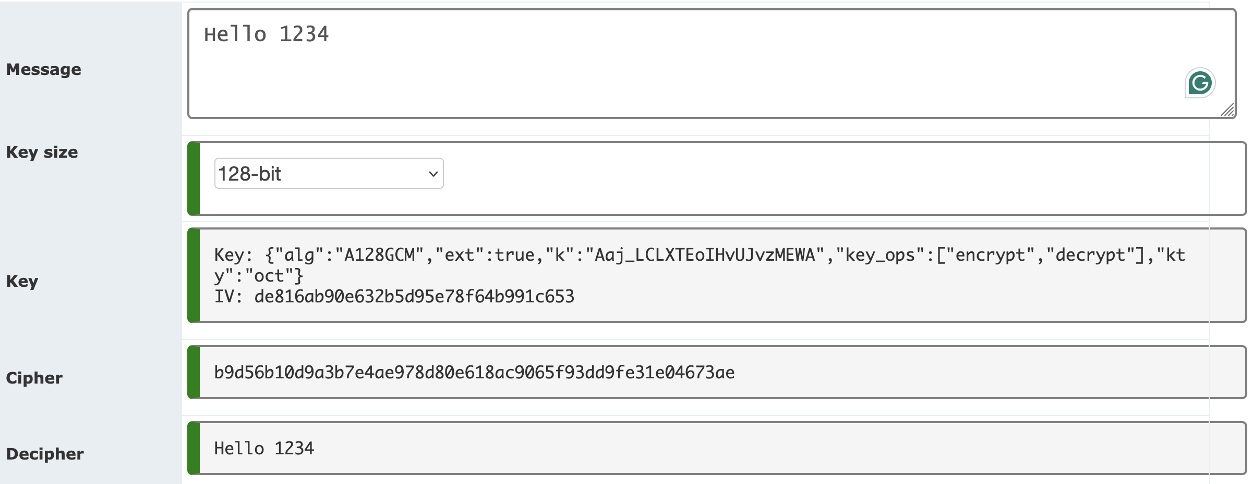
AES Modes
AES GCM with Web Cryptography and JavaScript. AES GCM with Web Cryptography and JavaScript.
AES CBC with Web Cryptography and JavaScript. AES CBC with Web Cryptography and JavaScript.
AES CTR with Web Cryptography and JavaScript. AES CTR with Web Cryptography and JavaScript.
JWT- JSON Web Token

Slide 44
2. Symmetric Key Basics Block or Stream? Secret Key Methods Salting AES 3DES
ChaCha20/Poly1305 and RC4 Key Entropy Cloud-based Symmetric Key Prof Bill Buchanan OBE, FRSE https://asecuritysite.com/symmetric

Slide 45
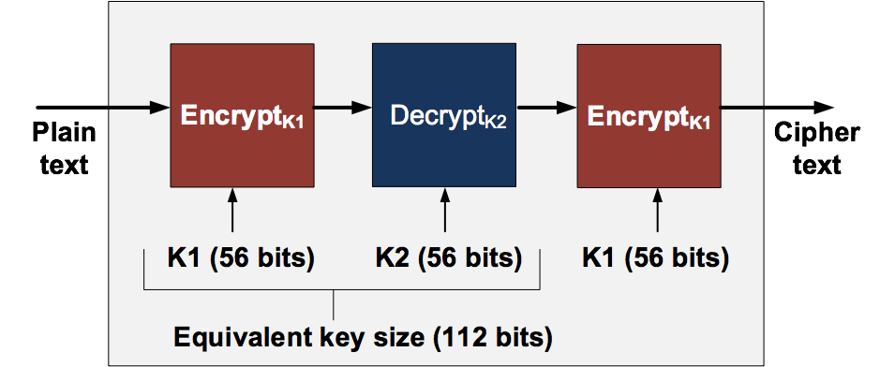
3-DES

Slide 46
2. Symmetric Key Basics Block or Stream? Secret Key Methods Salting AES 3DES
ChaCha20/Poly1305 and RC4 Key Entropy Cloud-based Symmetric Key Prof Bill Buchanan OBE, FRSE https://asecuritysite.com/symmetric

Slide 47
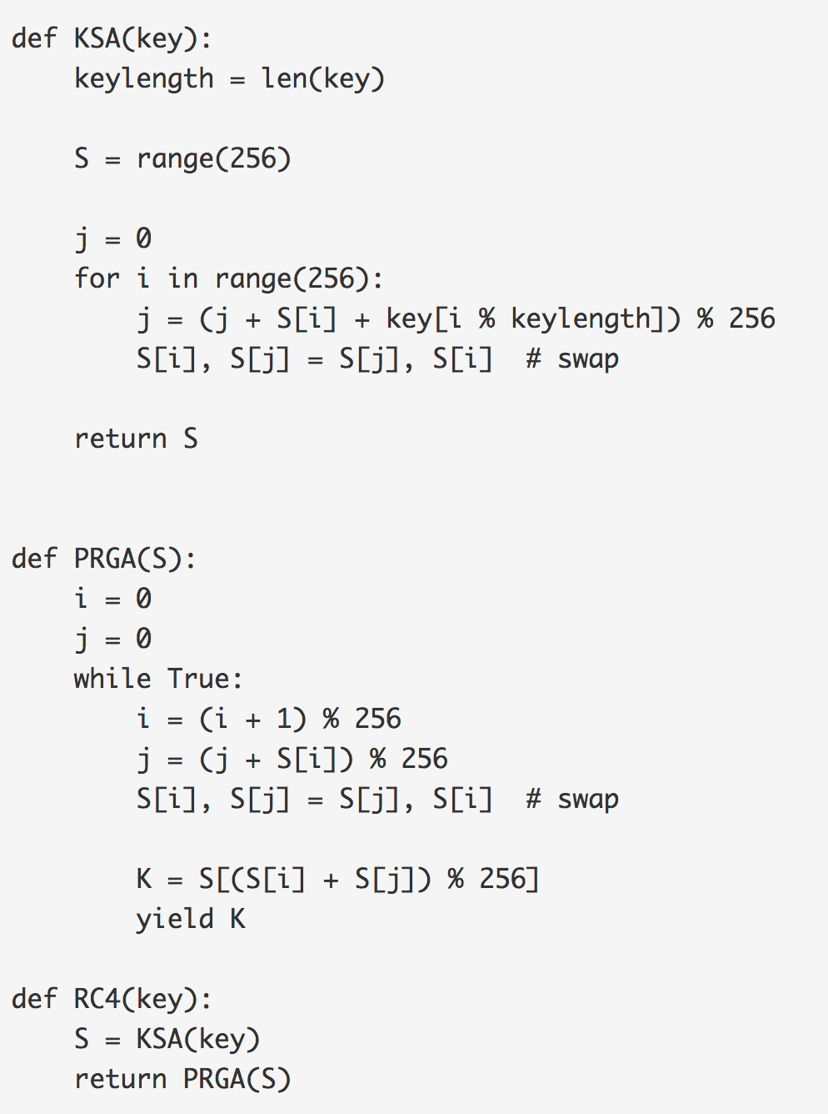
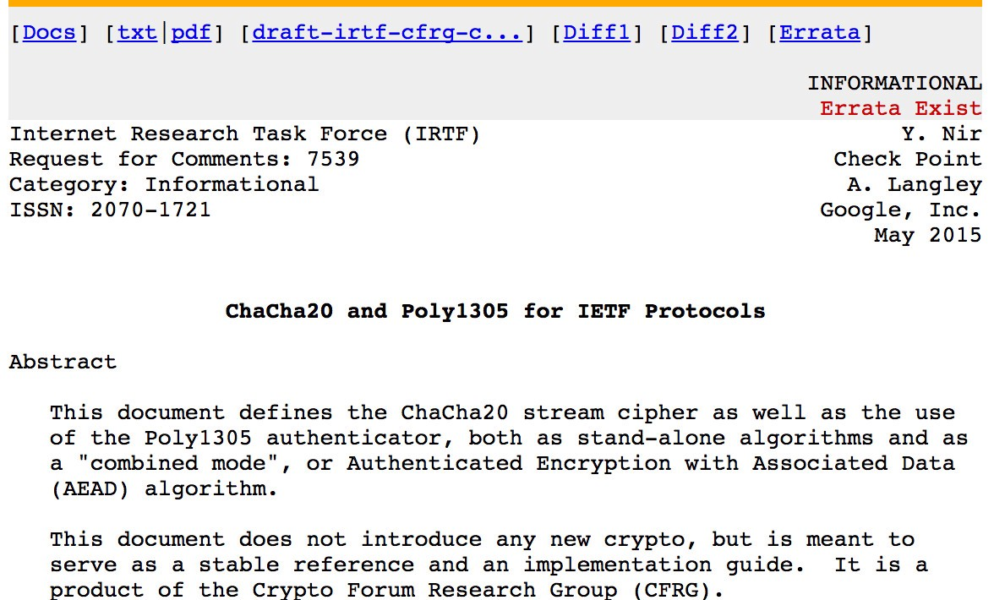
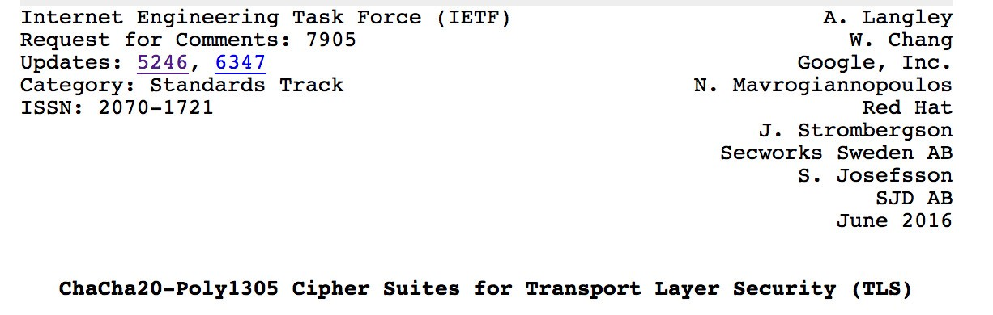
Try!
Try!
ChaCha20 and Salsa take a 256-bit key (or a 128-bit version) and a 32-bit nonce. This creates a key stream, which is then XORed with the plaintext stream. In software, it is more than three times faster than AES, and is well suited to lower-powered devices and in real-time communications.
ChaCha operates on 32-bit bits with a key of 256 bits (K=(k0, k1, k2, k3, k4, k5, k6, k7). This output blocks of 512-bits for the key stream (Z), and which is EX-ORed with the plaintext stream.

Slide 48
2. Symmetric Key Basics Block or Stream? Secret Key Methods Salting AES 3DES
ChaCha20/Poly1305 and RC4 Key Entropy Cloud-based Symmetric Key Prof Bill Buchanan OBE, FRSE https://asecuritysite.com/symmetric

Slide 49
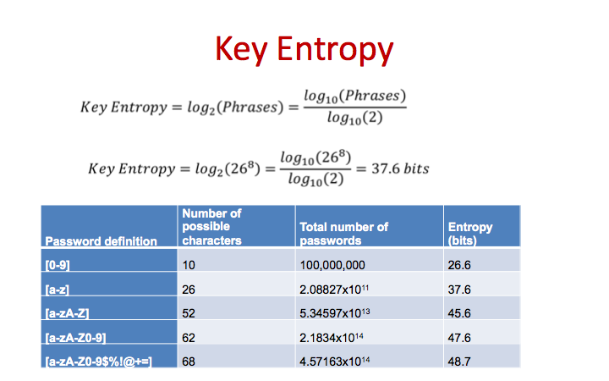

Try!

Slide 50
2. Symmetric Key Basics Block or Stream? Secret Key Methods Salting AES 3DES
ChaCha20/Poly1305 and RC4 Key Entropy Cloud-based Symmetric Key Prof Bill Buchanan OBE, FRSE https://asecuritysite.com/symmetric

Slide 51
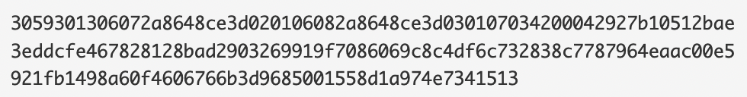
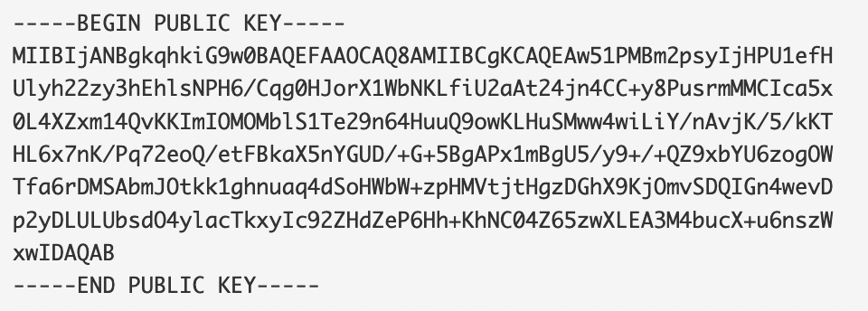
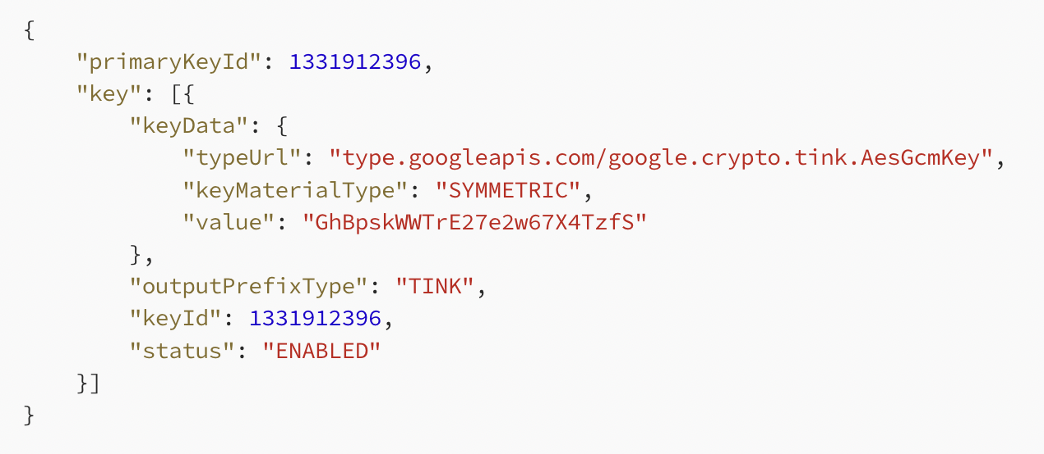
Key Storage/Transport
PEM format
DER format
JSON format

Slide 52
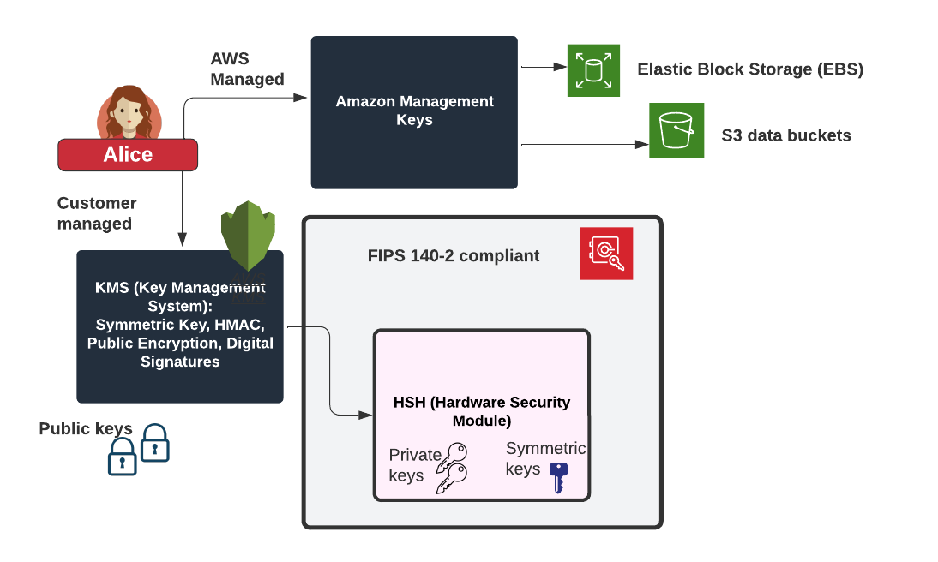
KMS and HSM

Slide 53
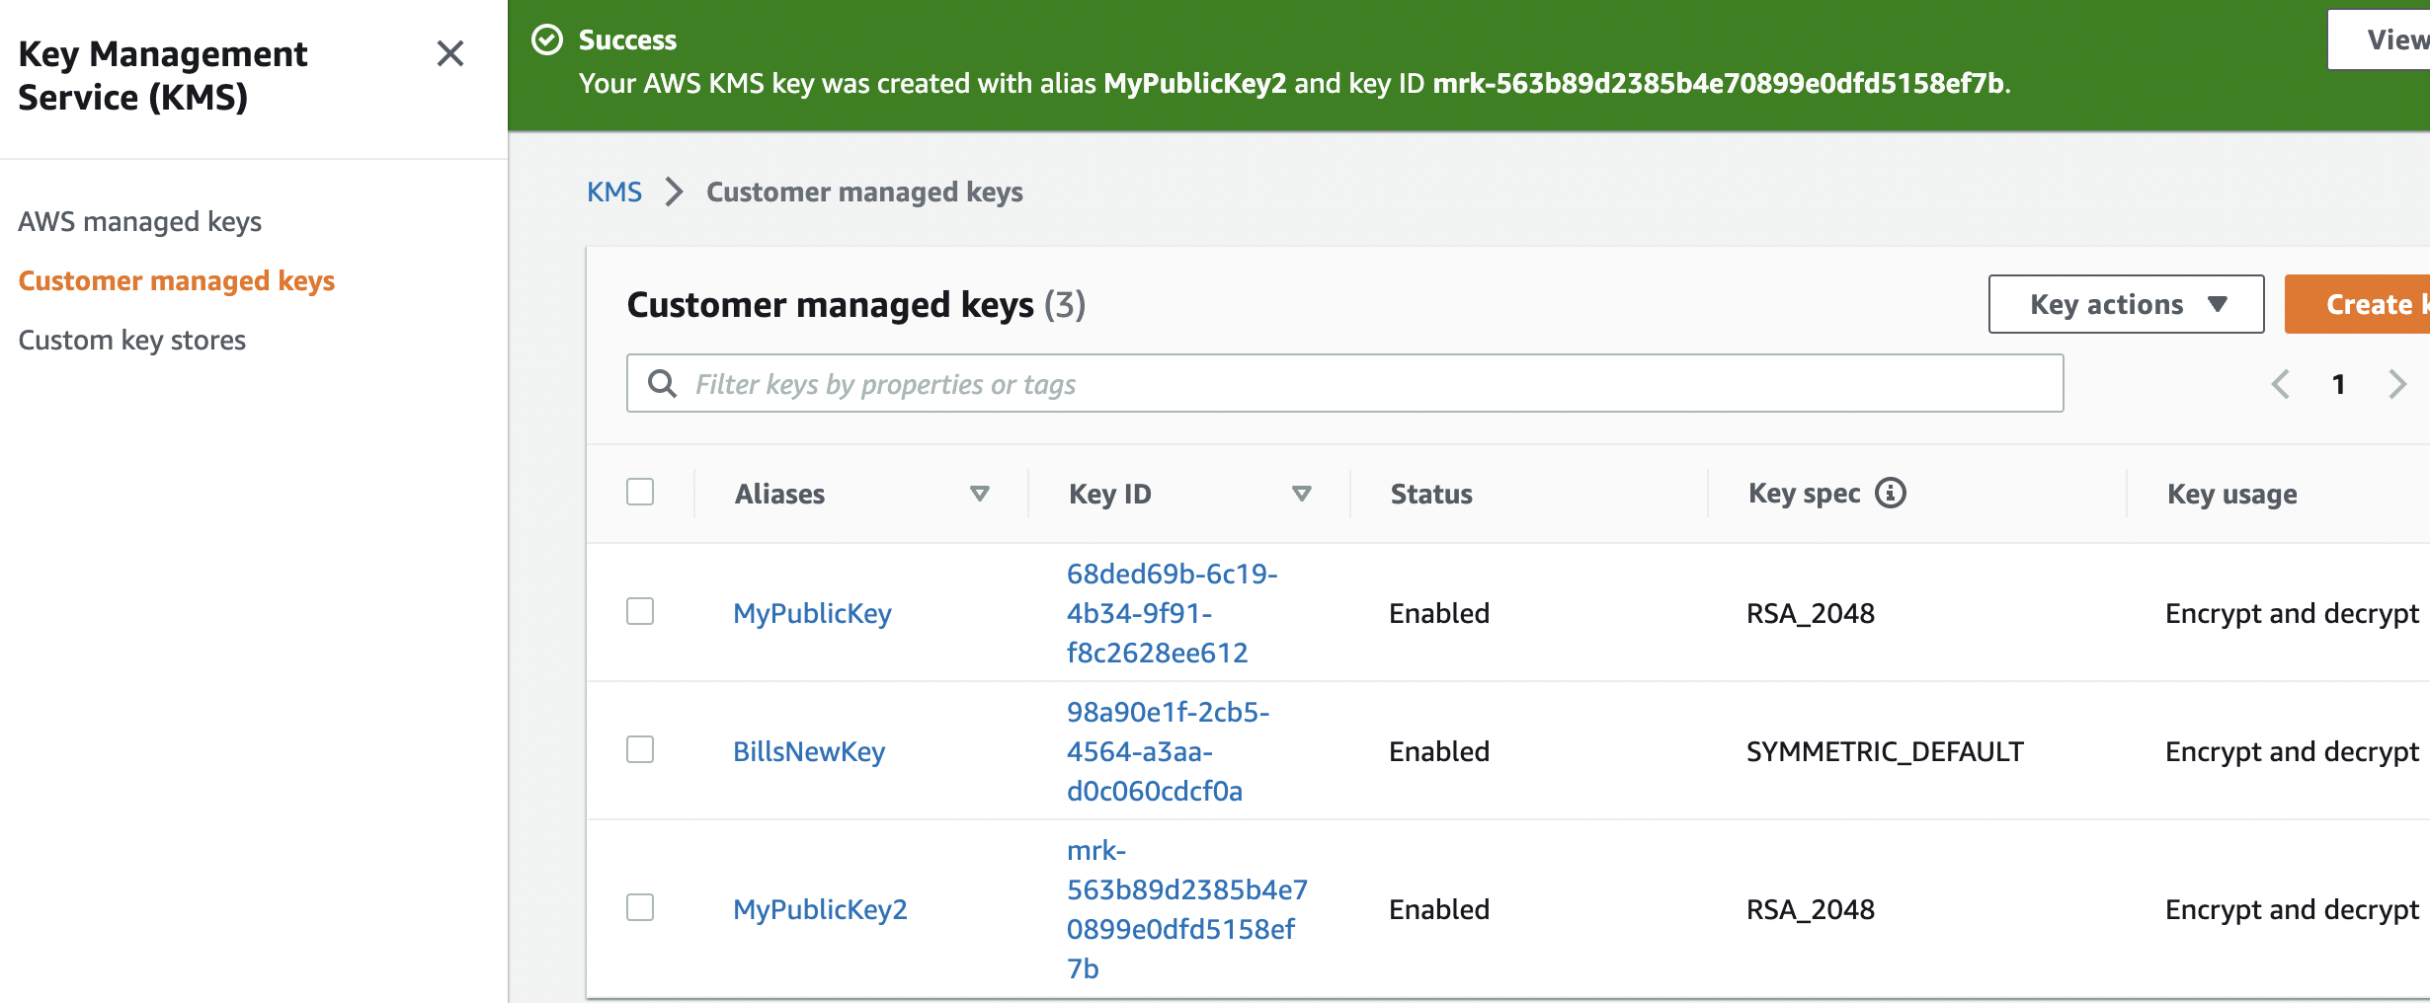


Cloud-based Symmetric Key

Slide 54
2. Symmetric Key Basics Block or Stream? Secret Key Methods Salting AES 3DES
ChaCha20/Poly1305 and RC4 Key Entropy Cloud-based Symmetric Key Prof Bill Buchanan OBE, FRSE https://asecuritysite.com/symmetric

Slide 55


Quiz
Menti.com
3722 3628

